Slide 1
Application Delivery Fundamentals 2.0 B: Java
Introduction to Maven

Slide 2
Course Goals / Objectives
At the end of this module, participants will be able to understand:
The Physical Overview of Maven3
The Maven repositories
Maven Archetypes
Maven 3 life cycle phases
How to set the environment for Maven 3

Slide 3
Course Goals / Objectives
At the end of this module, participants will be able to understand:
The pom.xml file
How to customize the pom.xml file
How to create Eclipse related files using Maven
How to create a WAR file

Slide 4
Java Application Build Steps
Compiling all source files
Compiling unit test codes
Configuring all the dependent files
Managing the project structure
Building war files
Java Application Build
Notes:
Faculty Notes:
Building a Java web application is very hard and can be a very tedious task. Typical build steps are as follows:
* Compiling all source files. Copying all class files to a temporary directory.
* Compiling unit test source codes and then run unit tests. Stopping the build process if a unit test fails.
* Transferring other required files (xml, properties, etc) to the temporary directory.
* Copying all the web content files.
* Building the war file.
Participant Notes:
We have created several Java applications till now in the course. We managed the build steps manually till now. However, when we deal large enterprise applications building the application and taking care of the dependencies could become very tedious
Transition:
Let’s have a look at some of the common issues

Slide 5
Issues
Common Issues
Configuring multiple jars
Managing Dependencies
Managing Project structure
Deploying
Building and testing modules
Notes:
Faculty Notes:
Imagine a large application with different modules eg: order, inventory etc and for some reason we want to create a separate war file for each of the modules. And then there is a common module which all of these depend on which has to be created as a jar and included in all war files.
While building a real time application we should take care of multiple modules, sequence in which modules need to be built and deploy it to various servers/environments like testing, production etc. Performing this manually would be difficult. Thus, in scenarios like this we use a build tool which helps us automate the process.

Slide 6

What is Maven ?
Build tool
A software project management and comprehension tool.
It can manage the build of project, documentation and reporting from a central piece of information
Maven is hosted by Apache Software Foundation
Notes:
Faculty Notes:
You can download Maven 2 from http://maven.apache.org/download.html.

Slide 7
What is Maven ?
Maven is a project management tool which encompasses a project object model.
a set of standards, a project lifecycle, a dependency management system, and logic for executing plugin goals at defined phases in a lifecycle.
Notes:
Faculty Notes:
You can download Maven 2 from http://maven.apache.org/download.html.

Slide 8
What is Maven ?
Maven uses POM (Project Object Model) in order to describe the software project which is being built, it’s dependencies on other external modules and build order.
Notes:
Faculty Notes:
You can download Maven 2 from http://maven.apache.org/download.html.

Slide 9
What is Maven ?
Maven comes with predefined targets for performing certain tasks like compilation of code and it’s packaging.
Maven is network-ready. The core engine can dynamically download plug-ins from a repository.
Notes:
Faculty Notes:
You can download Maven 2 from http://maven.apache.org/download.html.

Slide 10
Apache Ant vs Maven
Apache Ant
Ant doesn’t have formal conventions like a common project directory structure or default behaviour.
You have to tell Ant exactly where to find the source and where to put the output.
Informal conventions have emerged over time, but they haven’t been codified into the product.
Ant is procedural. You have to tell Ant exactly what to do and when to do it.
You have to tell it to compile, then copy, then compress.
Ant doesn’t have a lifecycle. You have to define goals and goal dependencies.
You have to attach a sequence of tasks to each goal manually.

Slide 11
Apache Ant vs Maven
Apache Maven
Maven has conventions. It knows where your source code is because you followed the convention.
Maven’s Compiler plugin put the bytecode in target/classes, and it produces a JAR file in target.
Maven is declarative. All you had to do was create a pom.xml file and put your source in the default directory. Maven took care of the rest.
Maven has a lifecycle which was invoked when you executed mvn install.
This command tells Maven to execute a series of sequential lifecycle phases until it reached the install lifecycle phase.
As a side effect of this journey through the lifecycle, Maven executed a number of default plugin goals which did things like compile and create a JAR.

Slide 12
Setting the environment for Maven 3.6.3
Download Maven3 from https://mirrors.estointernet.in/apache/
Unzip the installation archive to E:/
Set the M2_HOME and Path environment variables in the following way:
M2_HOME=E:\software\A08\file\apache-maven-3.6.1-bin\apache-maven-3.6.1
Path=%M2_HOME%\bin

Slide 13
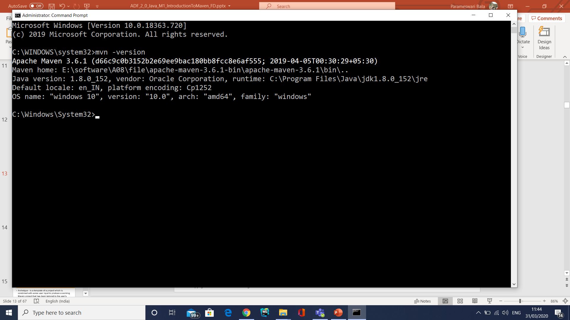
Setting the environment for Maven 2
If installed correctly, you should be able to test it by opening a command prompt and typing :
The output should be like this:

Slide 14
User-Specific Configuration and Repository
~/.m2/settings.xml
A file containing user-specific configuration for authentication, repositories, and other information to customize the behaviour of Maven.
~/.m2/repository/
This directory contains your local Maven repository. When you download a dependency from a remote Maven repository, Maven stores a copy of the dependency in your local repository.

Slide 15
Maven Settings File
<settings xmlns="http://maven.apache.org/SETTINGS/1.0.0"
xmlns:xsi="http://www.w3.org/2001/XMLSchema-instance"
xsi:schemaLocation="http://maven.apache.org/SETTINGS/1.0.0
http://maven.apache.org/xsd/settings-1.0.0.xsd">
<localRepository/>
<interactiveMode/>
<usePluginRegistry/>
<offline/>
<pluginGroups/>
<servers/>
<mirrors/>
<proxies/>
<profiles/>
<activeProfiles/>
</settings>

Slide 16
Maven Settings File
ELEMENT NAME | DESCRIPTION
localRepository | Maven stores copies of plug-ins and dependencies locally in the C:\Users\<your_user_name>\.m2\repository folder. This element can be used to change the path of the local repository.
interactiveMode | As the name suggests, when this value is set to true, the default value, Maven interacts with the user for input.
usePluginRegistry | It decide that if Maven should use the ${user.home}/.m2/plugin-registry.xml file to manage plugin versions. Its default value is false.
offline | When set to true, this configuration instructs Maven to operate in an offline mode. The default is false.

Slide 17
Maven Settings File
pluginGroups | It contains a list of pluginGroup elements, each contains a groupId. The list is searched when a plugin is used and the groupId is not provided in the command line. This list automatically contains org.apache.maven.plugins and org.codehaus.mojo.
servers | Maven can interact with a variety of servers, such as Apache Subversion (SVN) servers, build servers, and remote repository servers. This element allows you to specify security credentials, such as the username and password, which you need to connect to those servers.
mirrors | As the name suggests, mirrors allow you to specify alternate locations for your repositories.
proxies | proxies contains the HTTP proxy information needed to connect to the Internet.
profiles | profiles allow you to group certain configuration elements, such as repositories and pluginRepositories.
activeProfile | The activeProfile allows you to specify a default profile to be active for Maven to use.

Slide 18
Settings.xml
Indicates if maven should interact with the user for input. Is a true/false field. Defaults to true.
This option can be useful when we want to create an empty and default java project.
mvn archetype:generate -DgroupId=com.example -DartifactId=DemoJava -DarchetypeArtifactId=maven-archetype-quickstart -DinteractiveMode=false

Slide 19
Settings.xml
usePluginRegistry
There is a file called plugin-registry.xml in ${user.home}/.m2 folder. This field indicates if maven should use that file to manage plugins versions. Defaults to false.
The Maven 2 plugin registry (~/.m2/plugin-registry.xml) is a mechanism to help the user exert some control over their build environment.
Rather than simply fetching the latest version of every plugin used in a given build, this registry allows the user to get a plugin to a particular version, and only update to newer versions under certain restricted circumstances.
There are various ways to configure or bypass this feature, and the feature itself can be managed on either a per-user or global level.

Slide 20
Settings.xml
offline
Indicates if maven should work in offline mode, this is, maven can not connect to remote servers. Defaults to false.
<?xml version="1.0" encoding="UTF-8"?>
<settings xmlns="http://maven.apache.org/SETTINGS/1.0.0"
xmlns:xsi="http://www.w3.org/2001/XMLSchema-instance"
xsi:schemaLocation="http://maven.apache.org/SETTINGS/1.0.0 http://maven.apache.org/xsd/settings-1.0.0.xsd">
<localRepository>${user.home}/.m2/repository</localRepository>
<interactiveMode>true</interactiveMode>
<usePluginRegistry>false</usePluginRegistry>
<offline>false</offline>
</settings>

Slide 21
Settings.xml
PluginGroups
The puglingGroup accepts multiples values, when a plugin is invoked, maven will search along this element in order to find the groupId for the plugin.
It makes more easy the maven execution.
You can define several plugins groupId, by default, it contains the following ones:
org.apache.maven.plugins
org.codehaus.mojo

Slide 22
Settings.xml
<pluginGroups>
<pluginGroup>org.mortbay.jetty</pluginGroup>
<pluginGroup>your.own.plugin.groupId</pluginGroup>
</pluginGroups>

Slide 23
Settings.xml
Servers
<servers>
<server>
<id>server_repo_java_code_geeks</id>
<username>john</username>
<password>doeIsMyPass</password>
<privateKey>${user.home}/.ssh/dsa_key</privateKey>
<passphrase>my_passphrase</passphrase>
<filePermissions>774</filePermissions>
<directoryPermissions>775</directoryPermissions>
<configuration></configuration>
</server>

Slide 24
Settings.xml
<server>
<id>server_repo_java_code_geeks_2</id>
<username>steve</username>
<password>steve_password</password>
<privateKey>${user.home}/.ssh/id_dsa</privateKey>
<passphrase>steve_passphrase</passphrase>
<filePermissions>664</filePermissions>
<directoryPermissions>775</directoryPermissions>
<configuration></configuration>
</server>
</servers>

Slide 25
Settings.xml
Mirrors
<mirrors>
<mirror>
<id>centralmirror</id>
<name>Apache maven central mirror Spain</name>
<url>http://downloads.centralmirror.com/public/maven</url>
<mirrorOf>maven_central</mirrorOf>
</mirror>
<mirror>
<id>jcg_mirror</id>
<name>Java Code Gueeks Mirror Spain</name>
<url>http://downloads.jcgmirror.com/public/jcg</url>
<mirrorOf>javacodegeeks_repo</mirrorOf>
</mirror>
</mirrors>

Slide 26
Settings.xml
Proxies
<proxies>
<proxy>
<id>jcg_proxy</id>
<active>true</active>
<protocol>http</protocol>
<host>proxy.javacodegueeks.com</host>
<port>9000</port>
<username>proxy_user</username>
<password>user_password</password>
<nonProxyHosts>*.google.com|javacodegueeks.com</nonProxyHosts>
</proxy>
</proxies>

Slide 27
Settings.xml
Profiles
<profiles>
<profile>
<id>test</id>
<activation>
<activeByDefault>false</activeByDefault>
<jdk>1.6</jdk>
<os>
<name>Windows XP</name>
<family>Windows</family>
<arch>x86</arch>
<version>5.1.3200</version>
</os>

Slide 28
Settings.xml
Profiles
<property>
<name>mavenVersion</name>
<value>3.0.3</value>
</property>
<file>
<exists>${basedir}/windows.properties</exists>
<missing>${basedir}/windows_endpoints.properties</missing>
</file>
</activation>
<properties>
<user.project>${user.home}/your-project</user.project>
<system.jks>${user.home}/your_jks_store</system.jks>
</properties>

Slide 29
Settings.xml
Profiles
<repositories>
<repository>
<id>codehausSnapshots</id>
<name>Codehaus Snapshots</name>
<releases>
<enabled>false</enabled>
<updatePolicy>always</updatePolicy>
<checksumPolicy>warn</checksumPolicy>
</releases>
<snapshots>
<enabled>true</enabled>
<updatePolicy>never</updatePolicy>
<checksumPolicy>fail</checksumPolicy>
</snapshots>

Slide 30
Settings.xml
Profiles
<url>http://snapshots.maven.codehaus.org/maven2</url>
<layout>default</layout>
</repository>
</repositories>
<pluginRepositories>
<pluginGroup>your.own.plugin.groupId</pluginGroup>
</pluginRepositories>
</profile>
</profiles>

Slide 31
Settings.xml
Active Profile
<activeProfiles>
<activeProfile>test</activeProfile>
</activeProfiles>
$mvn package -P prod
$ mvn package -D env=prod

Slide 32
Maven Key terms
Archetype - is a template of a project which is combined with some user input to produce a working Maven project that has been tailored to the user's requirements
POM - The pom.xml file is the core of a project's configuration in Maven. It is a single configuration file that contains the majority of information required to build a project.
Dependencies - Maven allows projects to declare what dependencies they have, and will automatically materialize those dependencies
Notes:
http://maven.apache.org/guides/getting-started/index.html

Slide 33
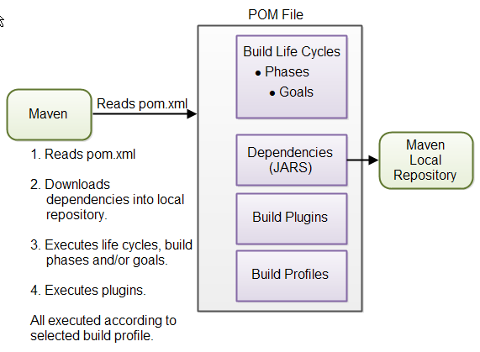
Physical Overview of Maven
Notes:
Faculty Notes:
POM is Maven’s understanding of your particular project.
Dependencies are specified as a part of pom.xml file. Maven resolves project dependencies according to it’s dependency management model. Maven 2 looks for dependent components in local and global repositories. In Maven terminology, the dependent components are known as artifacts. Artifacts resolved in remote repositories are download to the local repository.
Maven 2 can deal with transitive dependencies also. That is, Maven 2 works perfectly when resolving dependencies that your dependencies depend on.
All file handling tasks are performed by the Maven engine through plug-ins. Plug-ins are configured and described in the pom.xml file. The plug-ins are handled as artifacts by the dependency management model and are downloaded on demand. Each plug-in can be associated with various phases of a life cycle.

Slide 34
Physical Overview of Maven
pom.xml
Local & Remote
Repositories
Project Object
Model
Dependency
Management
Model
Project Life cycle and phases
Plug-in
Plug-in
Plug-in
Source files
Generated
Files
Resources
Binaries
Packaged Binaries
Notes:
Faculty Notes:
POM is Maven’s understanding of your particular project.
Dependencies are specified as a part of pom.xml file. Maven resolves project dependencies according to it’s dependency management model. Maven 2 looks for dependent components in local and global repositories. In Maven terminology, the dependent components are known as artifacts. Artifacts resolved in remote repositories are download to the local repository.
Maven 2 can deal with transitive dependencies also. That is, Maven 2 works perfectly when resolving dependencies that your dependencies depend on.
All file handling tasks are performed by the Maven engine through plug-ins. Plug-ins are configured and described in the pom.xml file. The plug-ins are handled as artifacts by the dependency management model and are downloaded on demand. Each plug-in can be associated with various phases of a life cycle.

Slide 35
What is Maven Build Lifecycle?
The sequence of steps which is defined in order to execute the tasks and goals of any maven project is known as build life cycle in maven.
Maven 2.0 version is basically a build life cycle oriented and clearly says that these steps are well defined to get the desired output after the successful execution of the build life cycle.

Slide 36
Maven Life Cycle
Maven comes with 3 built-in build life cycles as shown below :
Clean - this phase involves cleaning of the project (for a fresh build & deployment)
Default - this phase handles the complete deployment of the project
Site - this phase handles the generating the java documentation of the project.

Slide 37
Clean Life Cycle
When we execute mvn post-clean command, Maven invokes the clean lifecycle consisting of the following phases.
pre-clean
clean
post-clean
The clean: clean goal performs the deletion of the target directory which is the actual build directory.

Slide 38
Maven: Build Life Cycle of clean phase
Clean phase is used to clean up the project and make it ready for the fresh compile and deployment.
The command used for the same is mvn post-clean.
When mvn post-clean command is invoked, maven executes the below tasks via executing the below commands internally :
mvn pre-clean
mvn clean
mvn post-clean
This maven's clean is a goal and on executing it cleans up the output directory (target folder) by deleting all the compiled files.

Slide 39
Maven Life Cycle
Calling one phase of the clean lifecycle results in the execution of all phases up to an including that phase.
So, if we perform a "mvn clean", it will execute the pre-clean and the clean phases.
If we perform a "mvn post-clean", it will execute the pre-clean, clean, and post-clean phases.
The pre-clean phase can be used for any tasks required prior to cleanup.
The post-clean phase can be used for tasks following the cleanup.

Slide 40
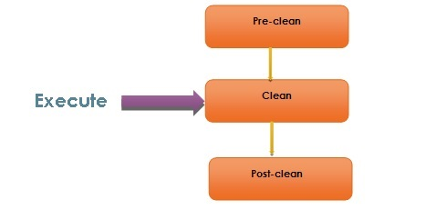
Maven: Build Life Cycle of clean phase
Whenever a maven command for any life cycle is invoked, maven executes the phases till and up to the invoked phase.
E.g. when 'mvn clean' is invoked, maven will execute only the phase clean.
But, no compile/deployment/site phase is invoked.

Slide 41
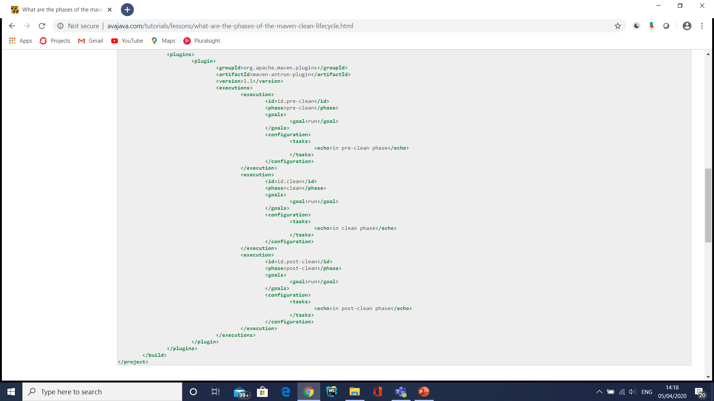
Maven: Build Life Cycle of clean phase

Slide 42
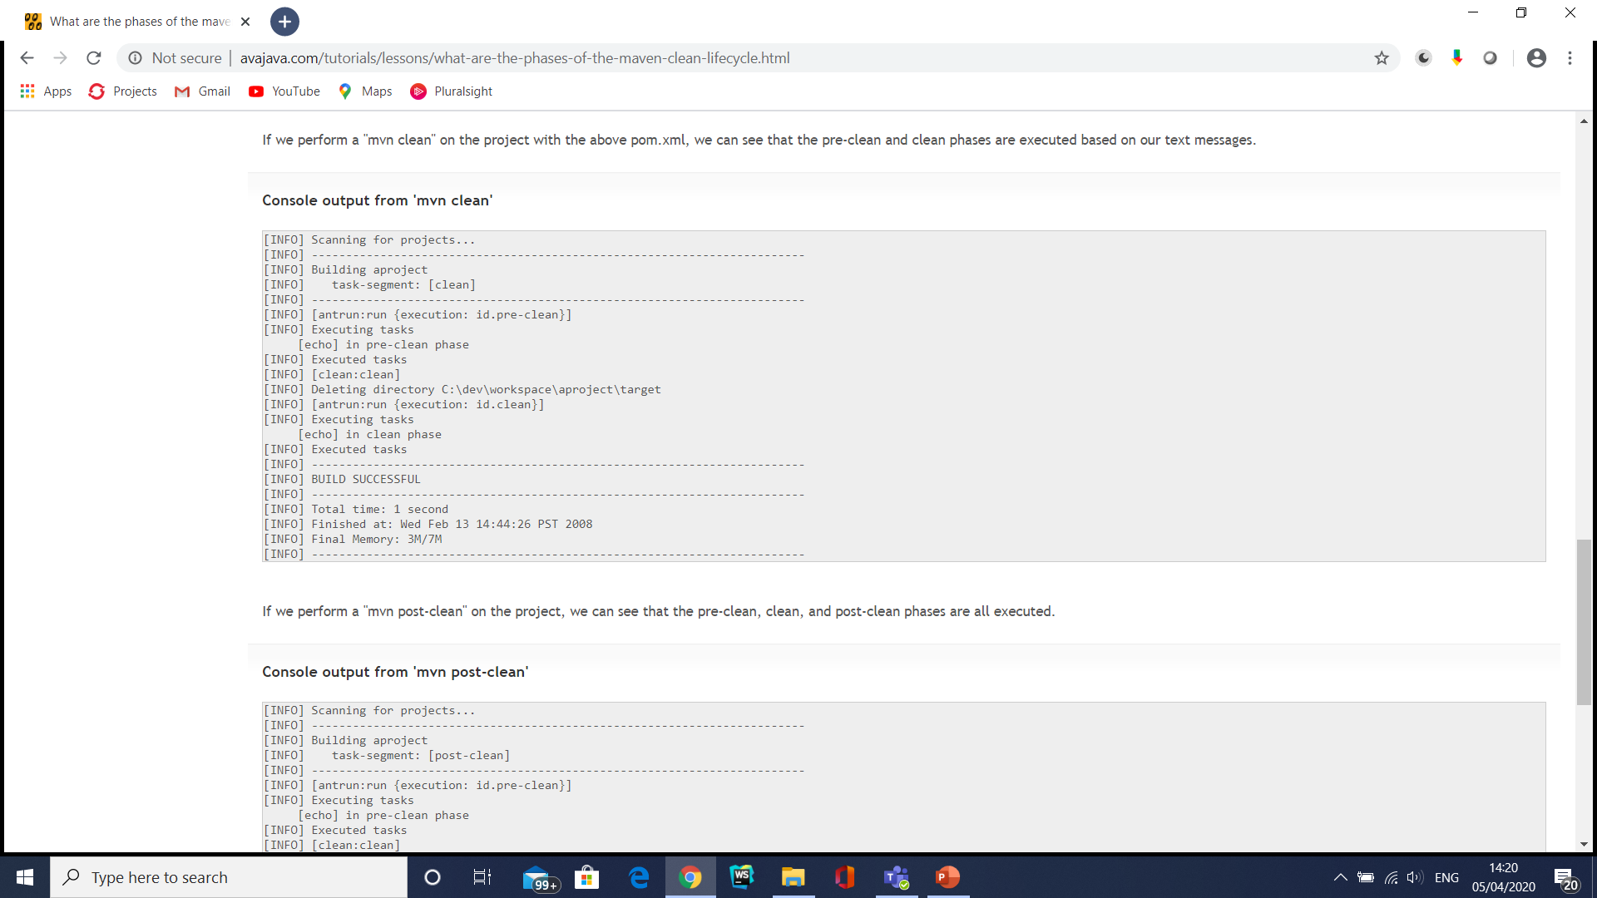
Maven: Build Life Cycle of clean phase

Slide 43
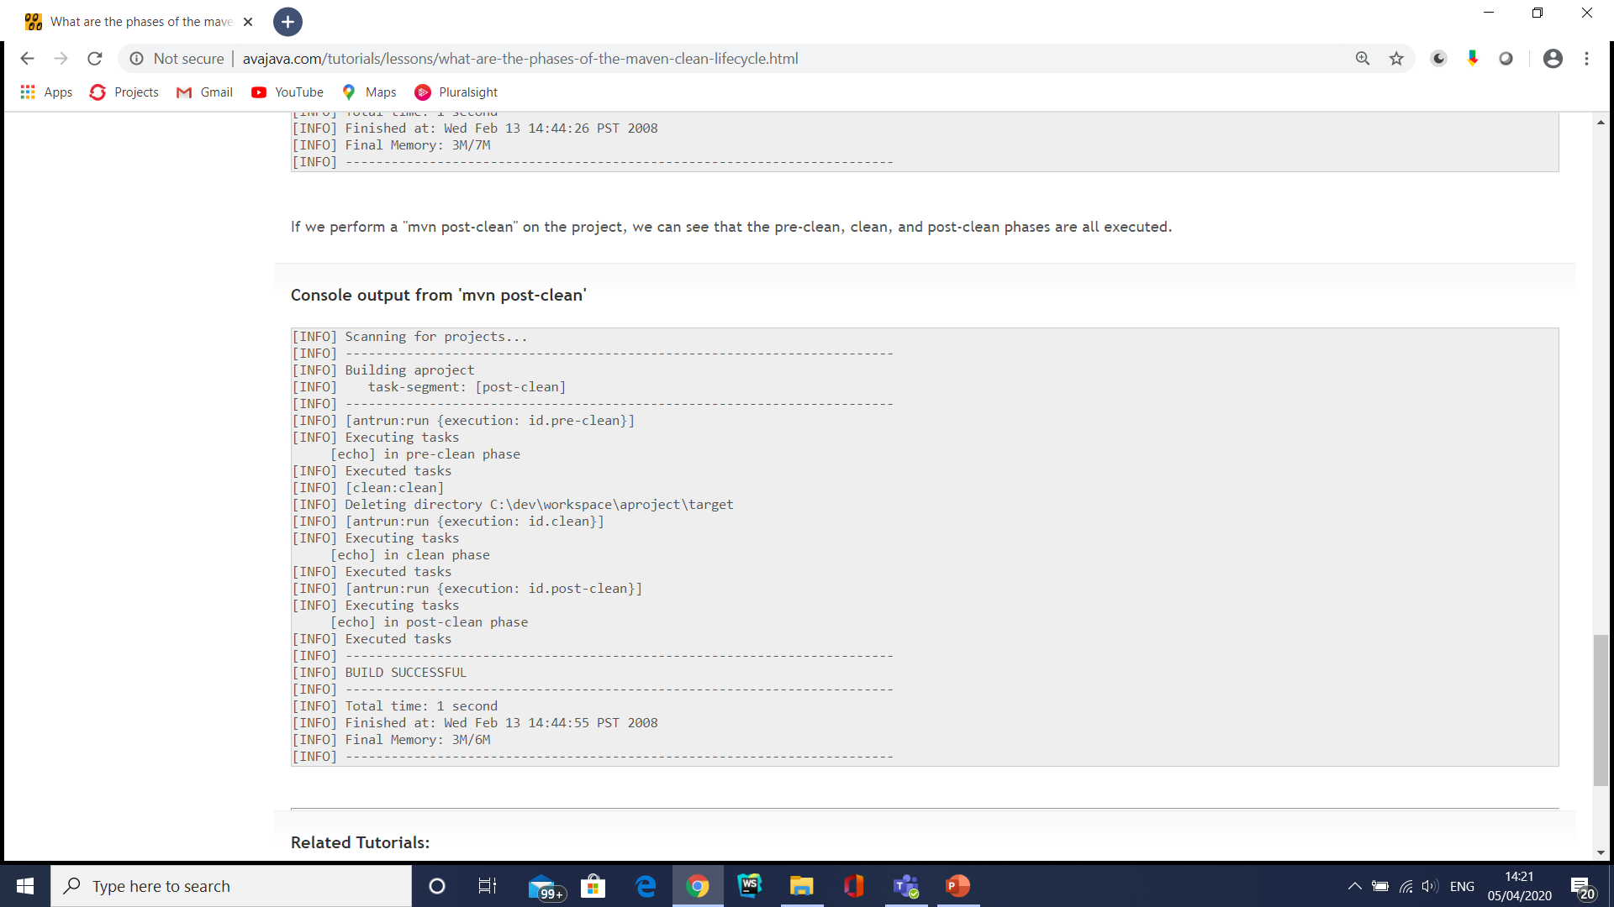
Maven: Build Life Cycle of clean phase

Slide 44
Site Lifecycle
Maven Site plugin is generally used to create fresh documentation to create reports, deploy site, etc. It has the following phases −
pre-site
site
post-site
site-deploy

Slide 45
Maven Default Lifecycle
validate: This phase validates the project POM file and makes sure all the necessary information related to carry out the build is available.
initialize: This phase initializes the build by setting up the right directory structure and initializing properties.
generate-sources: This phase generates any required source code.
process-sources: This phase processes the generated source code. For example, there can be a plugin running in this phase to filter the source code based on some defined criteria.
generate-resources: This phase generates any resources that need to be packaged with the final artifact.

Slide 46
Maven Default Lifecycle
process-resources: This phase processes the generated resources. It copies the resources to their destination directories and makes them ready for packaging.
compile: This phase compiles the source code.
process-classes: This phase can be used to carry out any bytecode enhancements after the compile phase.
generate-test-sources: This phase generates the required source code for tests.
process-test-sources: This phase processes the generated test source code. For example, there can be a plugin running in this phase to filter the source code based on some defined criteria.

Slide 47
Maven Default Lifecycle
generate-test-resources: This phase generates all the resources required to run tests.
process-test-resources: This phase processes the generated test resources. It copies the resources to their destination directories and makes them ready for testing.
test-compile: This phase compiles the source code for tests.
process-test-classes: This phase can be used to carry out any bytecode enhancements after the test-compile phase.

Slide 48
Maven Default Lifecycle
test: This phase executes tests using the appropriate unit test framework.
prepare-package: This phase is useful in organizing the artifacts to be packaged.
package: This phase packs the artifacts into a distributable format, for example, JAR or WAR.
pre-integration-test: This phase performs the actions required (if any) before running integration tests. This may be used to start any external application servers and deploy the artifacts into different test environments.
integration-test: This phase runs integration tests.

Slide 49
Maven Default Lifecycle
post-integration-test: This phase can be used to perform any cleanup tasks after running the integration tests.
verify: This phase verifies the validity of the package. The criteria to check the validity needs to be defined by the respective plugins.
install: This phase installs the final artifact in the local repository.
deploy: This phase deploys the final artifact to a remote repository.

Slide 50
Maven Default Lifecycle

Slide 51
Maven Life Cycle (Default)

Slide 52
Maven Life Cycle (Default)

Slide 53
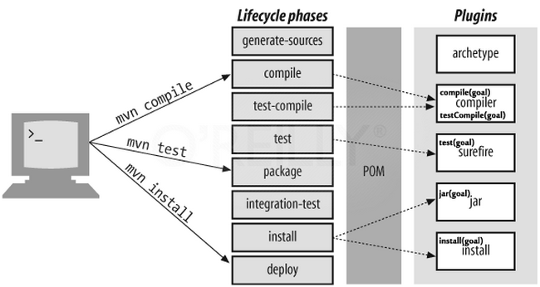
Maven Life Cycle (Default)

Slide 54
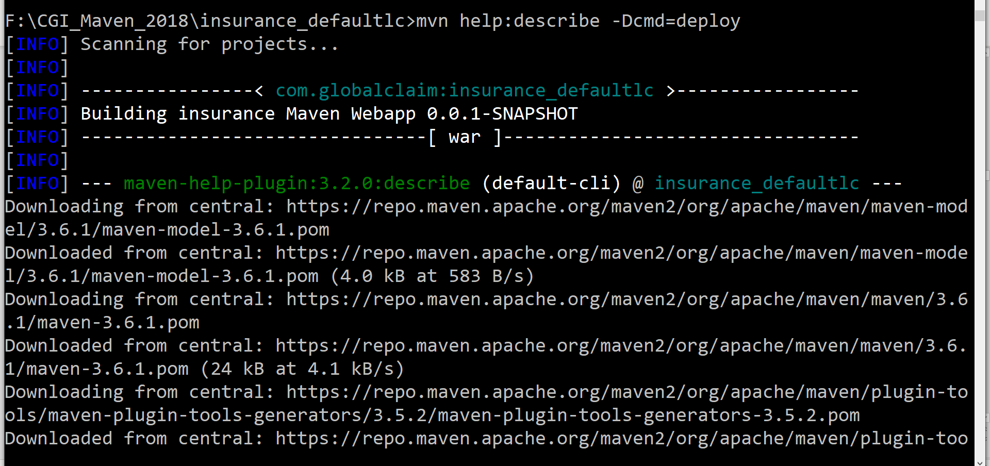
Maven Life Cycle (Default)
Mvn help:describe –Dcmd=clean

Slide 55
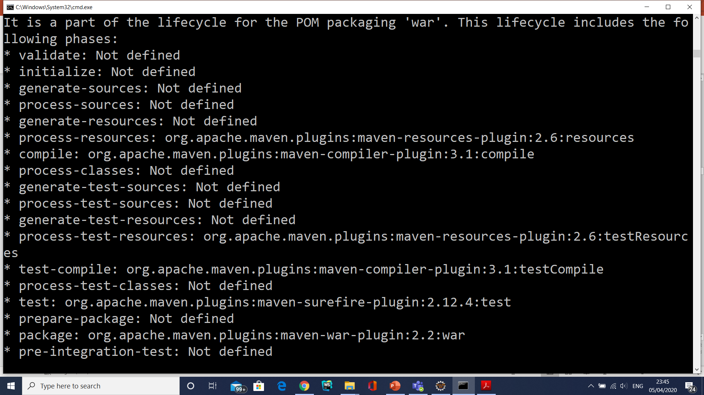
Maven Life Cycle (Default)

Slide 56
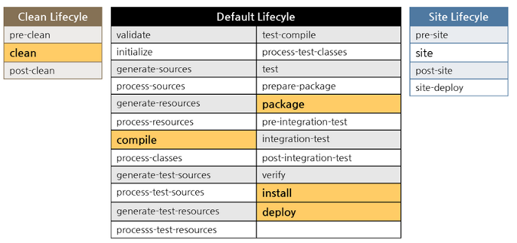
Maven Life Cycle (Default)

Slide 57
Maven Life Cycle (Default)
if we call a particular phase via a maven command, such as "mvn compile", all phases up to and including that phase will be executed.
So, in the case of "mvn compile", we would actually go through the validate, generate-sources, process-sources, generate-resources, process-resources, and compile phases.
The second main concept to be aware of in regards to lifecycles is that, based on the packaging of a project (jar, warW, earW, etc), different maven goals will be bound to different phases of the maven lifecycle.

Slide 58
Maven Life cycle phases
Plug-ins are software modules which are written to fit into the plug-in framework of Maven.
Each task within a plugin is called a mojo.
A mojo is executed when the Maven engine executes the corresponding phase on the build life cycle.
The association between the phase of a life cycle and a mojo is called as a binding.

Slide 59
Maven Life cycle phases (Continued…)
Few phases of the build life cycle are described below:
compile
Compiles the source code and the classes are placed in the target directory tree.
test-compile
Compiles the source code of the unit tests.
test
package
install
deploy
Adds the archive to the remote Maven directory. Thus making the artifact available to a larger audience.
Adds the archive to the local Maven directory. Thus making it available for any other module dependent on it.
Bundles the executable binaries into a distribution archive such as jar or war
Runs the compiled unit tests and verifies the results

Slide 60
Package-specific Lifecycles
JAR

Slide 61
Package-specific Lifecycles
WAR

Slide 63
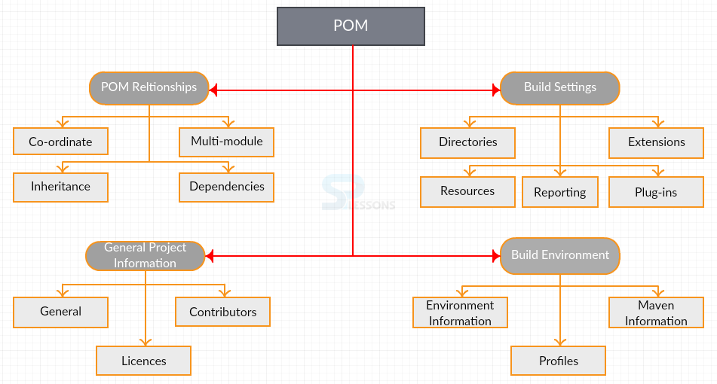

Slide 64
POM Major Elements
project –> root element
modelVersion –> mandatory element with value 4.0.0 which is currently supported version for both Maven 2 & 3
groupId –> this is the top-most element while considering maven repository structure and its generally kept unique amongst organization
artifactId –> this is similar to name of the project and this lies under <groupId> element
version –> this is final element in Maven co-ordinate system and generally it defines version of the project. Like, initially it can be kept 1.0 and later with couple changes version changes to 1.1 or 2.0 depending on the major/minor releases. Together with <groupId> & <artifactId> elements acts like an address and timestamp in one

Slide 65
POM Major Elements
name –> any meaningful name to the project
description –> description of the project
packaging –> this elements defines how exactly this project needs to be bundled or packaged after development. Various packaging standards in Java/JEE project developemtns are JAR or WAR or EAR. When no <packaging> element defined, then by default final products is packaged as JAR
url –> this elements can be used to define where exactly project going to live after development (normally it points to SVN location)
dependencies/dependency –> defines what are the required dependencies for this project into developments (dependency scopes and transitive dependencies)

Slide 66
POM Major Elements
build/plugins –> various plugins along with their goals can be configured under <build> element (Maven plugins)
finalName –> this is the child element under <build> element defining what will be final name of the project and a JAR or WAR or EAR will be generated under “target” folder with this name

Slide 67
Maven Repository
Maven repositories are directories of packaged JAR files with some metadata.
The metadata are POM files related to the projects each packaged JAR file belongs to, including what external dependencies each packaged JAR has.
This metadata enables Maven to download dependencies of your dependencies recursively until all dependencies are download and put into your local machine.
Maven has three types of repository :
Local repository
Central repository
Remote repository

Slide 68
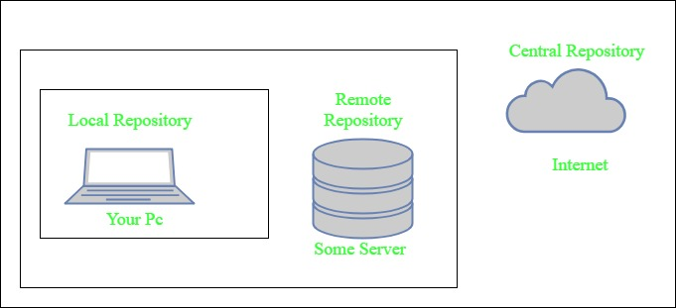
Maven Repository
Maven searches for dependencies in this repositories.
First maven searches in Local repository then Central repository then Remote repository if Remote repository specified in the POM.

Slide 69
Snapshot in Maven
SNAPSHOT can be defined as a special version that indicates a current development copy.
Unlike the regular versions, Maven checks for a new SNAPSHOT version in its remote repository. Maven does it for every build.

Slide 70
Snapshot in Maven
In the case of Version, if Maven once downloads the mentioned version say data-service:1.0, it will never try to download a newer 1.0 available in the repository.
To download the updated code, the data-service version is then upgraded to 1.1.
In the case of SNAPSHOT, Maven will automatically fetch the latest SNAPSHOT (data-service:1.0-SNAPSHOT) every time the team builds its project.

Slide 71
Dependency Management in Maven
Dependency management is a core feature of maven.
It is powerful enough to manage dependencies from a simple single project to a complex multi-module project.
There are basically 2 types of dependencies that maven manages, direct and transitive dependencies.

Slide 72
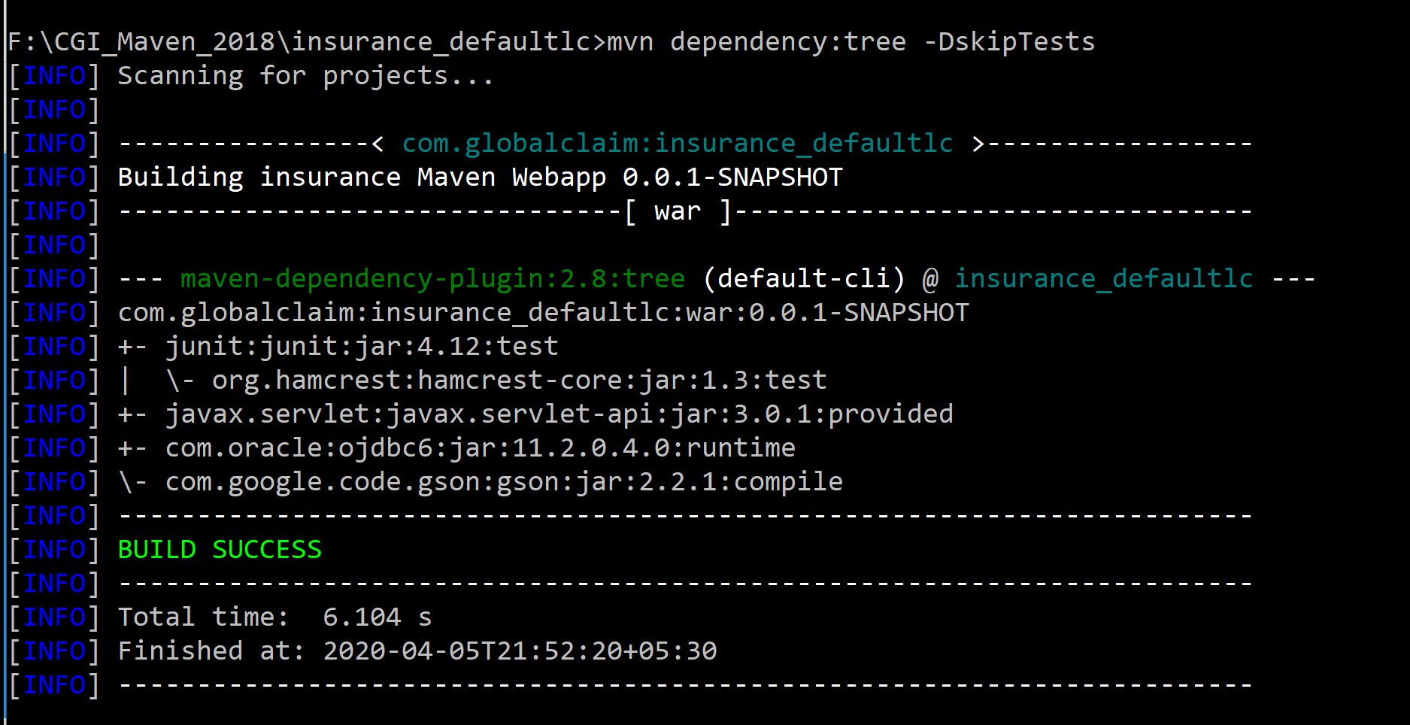
Maven dependency tree

Slide 73
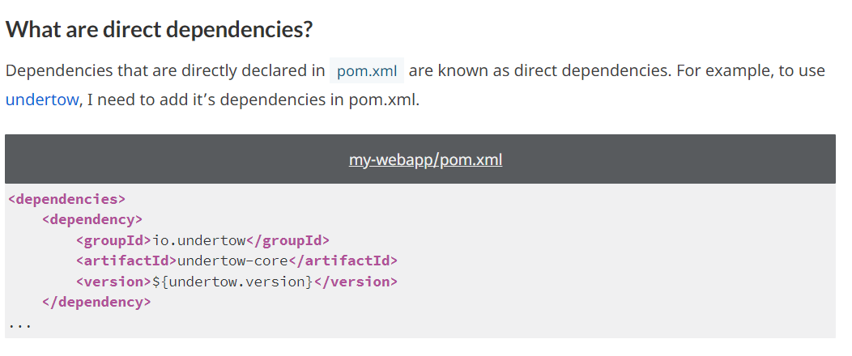
Direct Dependencies

Slide 74
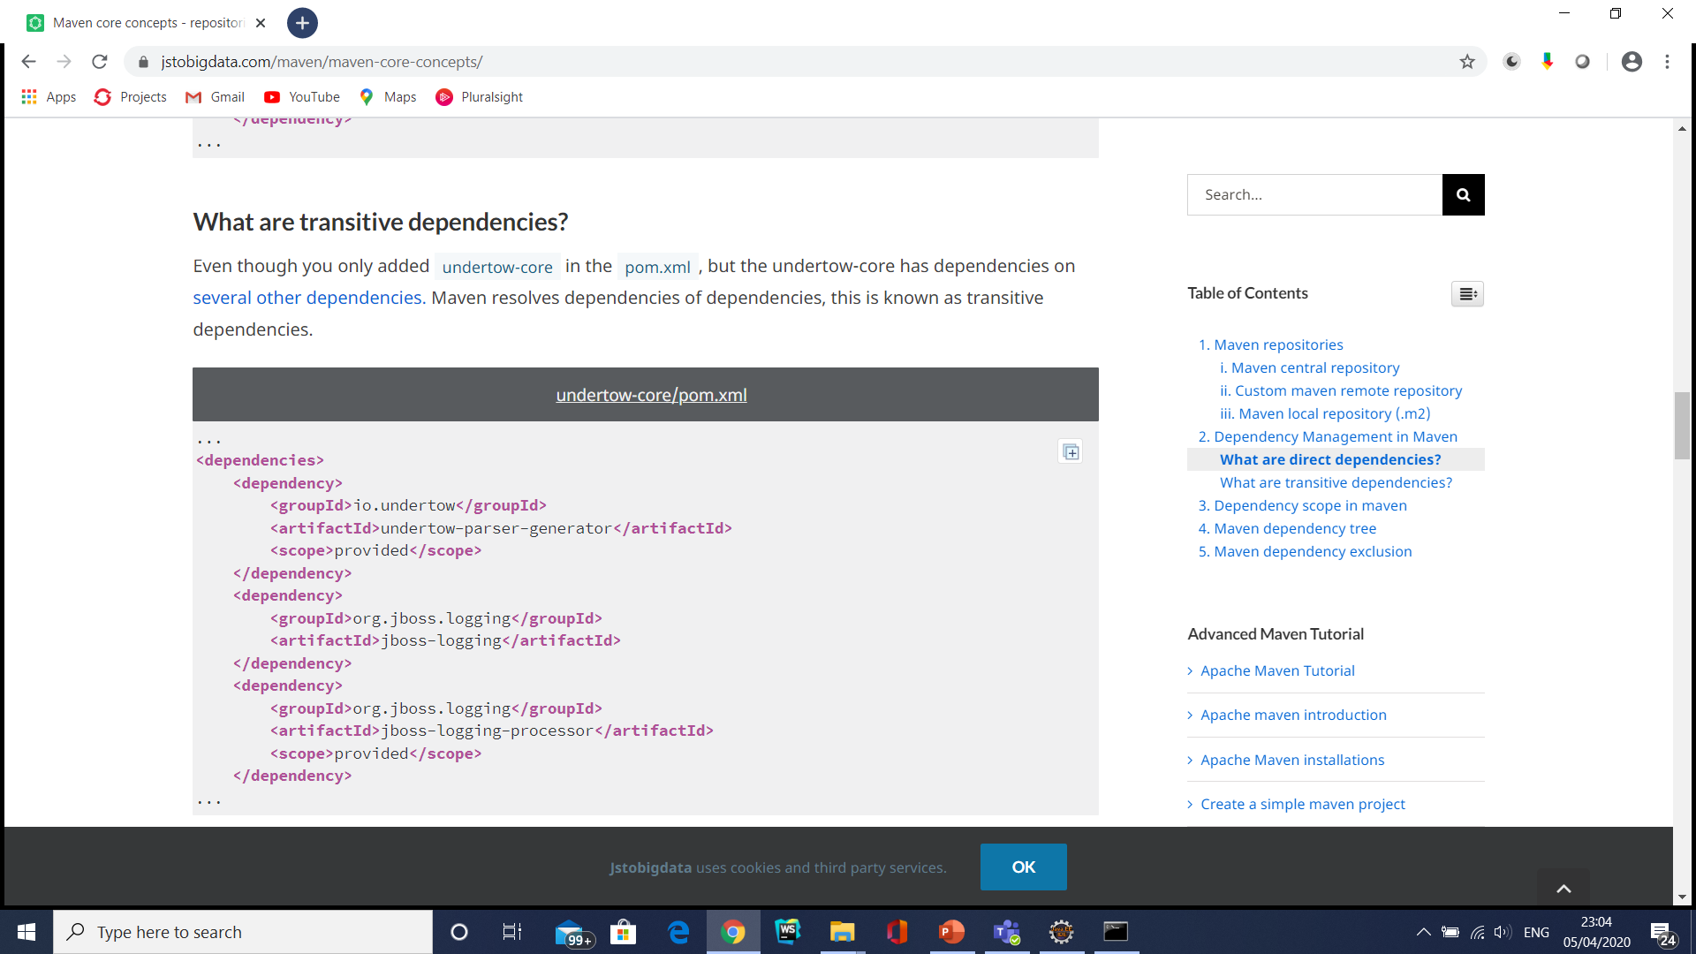
Transitive Dependencies

Slide 75
Transitive Dependency
Dependencies are transitive.
This means that if A depends on B and B depends on C, then A depends on both B and C.
Theoretically, there is no limit to the depth of dependency.
So, if you observe the following diagram of the tree of dependencies, you will notice that by transitivity, A depends on B, C, D, … until Z:

Slide 76
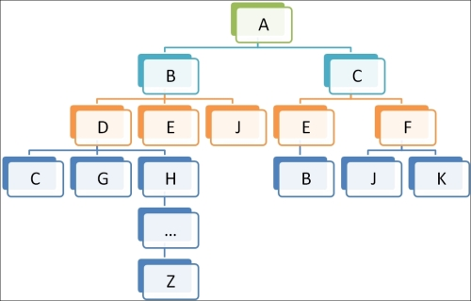
Transitive Dependency

Slide 77
Transitive Dependency
Resolution
Maven carries out the following algorithm to choose between two different versions:
Nearest first: A dependency of lower level has priority over another of the higher depth. Hence, a direct dependency has priority over a transitive dependency.
First found: At the same level, the first dependency that is found is taken.
This algorithm is known as dependency mediation.

Slide 78
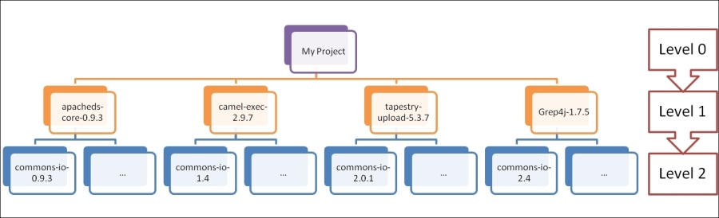
Transitive Dependency

Slide 79
Transitive Dependency
<dependencies>
<dependency>
<groupId>directory</groupId>
<artifactId>apacheds-core</artifactId>
<version>0.9.3</version>
<!--implicit dependency to commons-io:commons-io:1.0-->
</dependency>
<dependency>
<groupId>org.apache.camel</groupId>
<artifactId>camel-exec</artifactId>
<version>2.9.7</version>
<!--implicit dependency to commons-io:commons-io:1.4-->
</dependency>

Slide 80
Transitive Dependency
<dependency>
<groupId>org.apache.tapestry</groupId>
<artifactId>tapestry-upload</artifactId>
<version>5.3.7</version>
<!--implicit dependency to commons-io:commons-io:2.0.1-->
</dependency>
<dependency>
<groupId>com.googlecode.grep4j</groupId>
<artifactId>grep4j</artifactId>
<version>1.7.5</version>
<!--implicit dependency to commons-io:commons-io:2.4-->
</dependency>
<dependency>
<groupId>commons-io</groupId>
<artifactId>commons-io</artifactId>
<version>2.3</version>
</dependency>

Slide 81
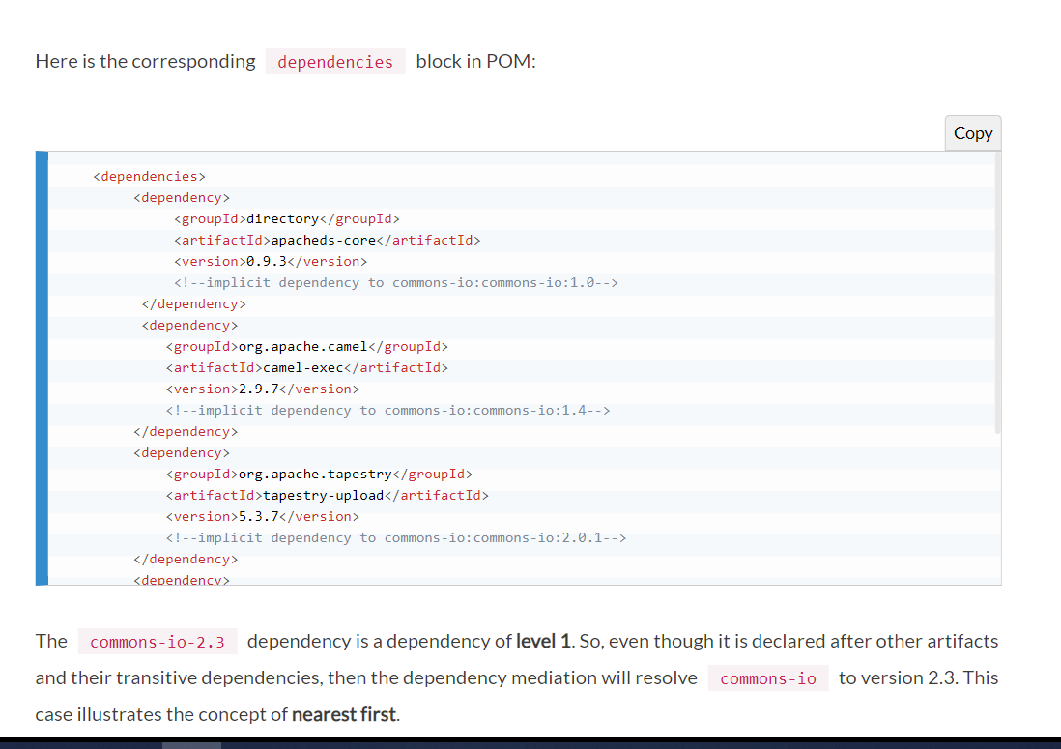
Transitive Dependency

Slide 82
Transitive dependency
The commons-io-2.3 dependency is a dependency of level 1.
So, even though it is declared after other artifacts and their transitive dependencies, then the dependency mediation will resolve commons-io to version 2.3.
This case illustrates the concept of nearest first.

Slide 83
Transitive Dependency

Slide 84
Transitive dependency
All dependencies to commons-io are of level 2, and differ on the versions: 0.9.3 (via apacheds-core), 1.4 (via camel-exec), 2.0.1 (via tapestry-upload), and 2.4 (via grep4j).
Unlike a popular belief, the resolution will not lead to take the greatest version number (that is, 2.4), but the first transitive version that appears in the dependency tree, in other terms 0.9.3.
Had another dependency been declared before apacheds-core, its embed version of commons-io would have been resolved instead of version 0.9.3. This case illustrates the concept of first found.

Slide 85
Conflict Resolution
There will be times when you need to exclude a transitive dependency, such as when you are depending on a project that depends on another project.
But you would like to either exclude the dependency altogether or replace the transitive dependency with another dependency that provides the same functionality.
Excluding a Transitive Dependency shows an example of a dependency element that adds a dependency on project-a, but excludes the transitive dependency project-b.

Slide 86
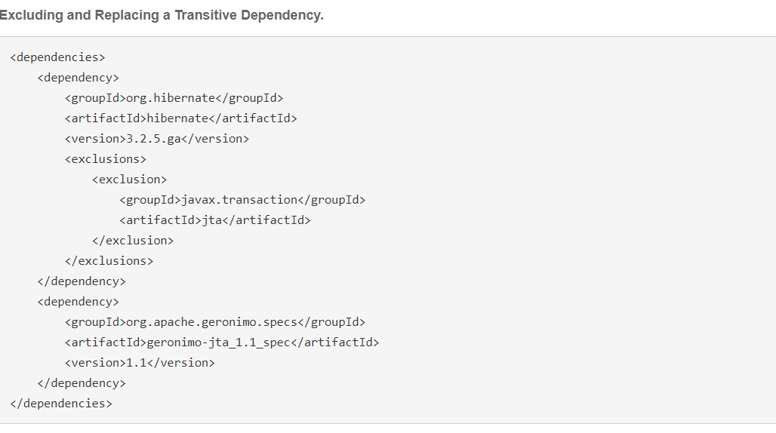
Conflict Resolution

Slide 87
Optional Dependency
Assume that you are working on a library that provides caching behavior.
Instead of writing a caching system from scratch, you want to use some of the existing libraries that provide caching on the file system and distributed caches.
Also assume that you want to give the end user an option to cache on the file system or to use an in-memory distributed cache.
To cache on the file system, you’ll want to use a freely available library called EHCache (http://ehcache.sourceforge.net/).
To cache in a distributed in-memory cache, you want to use another freely available caching library named SwarmCache ( http://swarmcache.sourceforge.net/ ).
You’ll code an interface and create a library that can be configured to use either EHCache or SwarmCache, but you want to avoid adding a dependency on both caching libraries to any project that depends on your library.

Slide 88
Optional Dependency
In other words, you need both libraries to compile this library project, but you don’t want both libraries to show up as transitive runtime dependencies for the project that uses your library.
You can accomplish this by using optional dependencies as shown in Declaring Optional Dependencies.

Slide 89
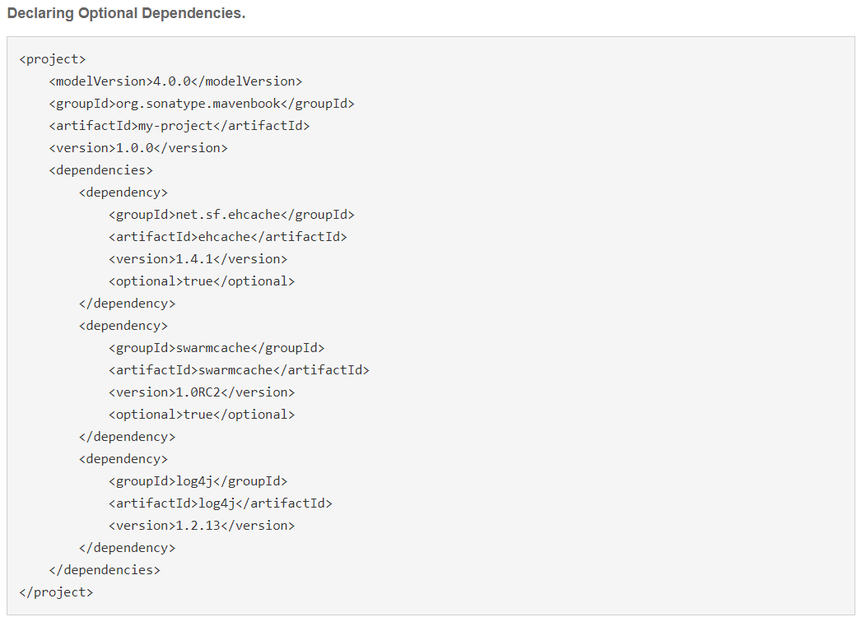
Optional Dependency

Slide 90
Project Dependency Scope
compile
This tells that dependency are needed for the compilation of main source files
Compile dependencies are available in all three classpaths mentioned above
These dependencies are propagated to dependent projects
Means transitive dependencies are included in the projects it is used and this can be cross-checked with project’s “WEB-INF\lib” folder
This is default scope, if nothing is specified in pom.xml

Slide 91
Maven dependency scope - compile
<dependencies>
<dependency>
<groupId>log4j</groupId>
<artifactId>log4j</artifactId>
<version>1.2.14</version>
<!-- You can omit this because it is default -->
<scope>compile</scope>
</dependency>
</dependencies>

Slide 92
Project Dependency Scope
provided
This is similar to “compile” dependencies with only exception that, it’s not available in runtime-classpath.
It assumes that runtime environment like JDK or web container provides the required/dependent JARS for their executions after deployment
This is available only in compile-classpath and test-classpath
This is not transitive
So, once after building/packaging the project, we can neither find direct dependencies nor transitive dependencies in project’s “WEB-INF\lib” folder which are scoped to “provided”

Slide 93
Project Dependency Scope
provided
For example, if you were developing a web application, you would need the Servlet API available on the compile classpath to compile a servlet, but you wouldn’t want to include the Servlet API in the packaged WAR; provided dependencies are available on the compilation classpath (not runtime). They are not transitive, nor are they packaged.

Slide 94
Maven dependency scope - provided
<dependency>
<groupId>javax.servlet</groupId>
<artifactId>servlet-api</artifactId>
<version>3.0.1</version>
<scope>provided</scope>
</dependency>

Slide 95
Project Dependency Scope
runtime
This dependency is not required for compilation, but very much required for their execution at runtime
Not exactly, but it is just opposite of “provided” scope which means dependency aren’t available in compile-classpath but available in runtime-classpath
This is available only in test-classpath and runtime-classpath
This is transitive in nature means transitive dependencies are packaged into project
We can cross-check at project’s “WEB-INF\lib” folder

Slide 96
Project Dependency Scope
runtime dependencies are required to execute and test the system, but they are not required for compilation.
For example, you may need a JDBC API JAR at compile time and the JDBC driver implementation only at runtime.
Test
This dependency available for test compilation and for their executions
Available in only test-classpath
This is not transitive
If we cross-check, then direct & their transitive dependencies aren’t available in project’s “WEB-INF\lib” folder
Note: This is not for normal use of the application

Slide 97
Maven dependency scope - runtime
<dependency>
<groupId>com.thoughtworks.xstream</groupId>
<artifactId>xstream</artifactId>
<version>1.4.4</version>
<scope>runtime</scope>
</dependency>

Slide 98
Maven dependency scope - test
<dependency>
<groupId>junit</groupId>
<artifactId>junit</artifactId>
<version>4.12</version>
<scope>test</scope>
</dependency>

Slide 99
Project Dependency Scope
test-scoped dependencies are not required during the normal operation of an application, and they are available only during test compilation and execution phases.
system
The system scope is similar to provided except that you have to provide an explicit path to the JAR on the local file system. This is intended to allow compilation against native objects that may be part of the system libraries.
Import
import scope is only supported on a dependency of type pom in the dependencyManagement section. It indicates the dependency to be replaced with the effective list of dependencies in the specified POM’s dependencyManagement section.

Slide 100
Maven dependency scope - system
<dependency>
<groupId>extDependency</groupId>
<artifactId>extDependency</artifactId>
<scope>system</scope>
<version>1.0</version>
<systemPath>${basedir}\war\WEB-INF\lib\extDependency.jar</systemPath>
</dependency>

Slide 101
Maven dependency scope – import
<dependencyManagement>
<dependencies>
<dependency>
<groupId>other.pom.group.id</groupId>
<artifactId>other-pom-artifact-id</artifactId>
<version>SNAPSHOT</version>
<scope>import</scope>
<type>pom</type>
</dependency>
</dependencies>
</dependencyManagement>

Slide 102
Maven Multi Module
As project size and complexity increases, it makes sense to split the project into multiple modules.
While it is always possible to split the project into multiple projects and link them as dependencies, it complicates the build process.
In Maven, the preferred approach is to structure the project as multi module project and delegate the rest to Maven.

Slide 103
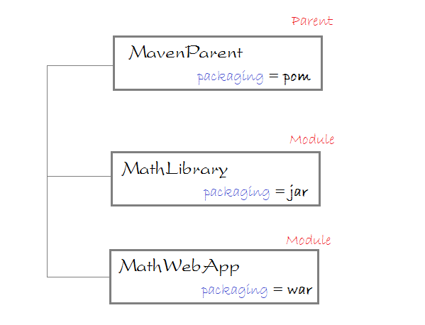
Multi Module Project

Slide 104
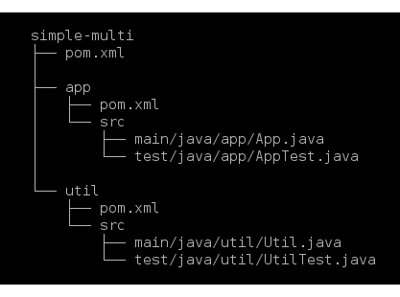
Maven Multi Module

Slide 105
Maven Multi Module
simple-multi/pom.xml
<project xmlns="http://maven.apache.org/POM/4.0.0" xmlns:xsi="http://www.w3.org/2001/XMLSchema-instance"
xsi:schemaLocation="http://maven.apache.org/POM/4.0.0 http://maven.apache.org/xsd/maven-4.0.0.xsd"> <modelVersion>4.0.0</modelVersion>
<groupId>org.codetab</groupId>
<artifactId>simple-multi</artifactId>
<version>1.0</version>
<packaging>pom</packaging>
<modules>
<module>app</module>
<module>util</module>
</modules></project>

Slide 106
Maven Multi Module
Util/pom.xml
<project xmlns="http://maven.apache.org/POM/4.0.0" xmlns:xsi="http://www.w3.org/2001/XMLSchema-instance"
xsi:schemaLocation="http://maven.apache.org/POM/4.0.0 http://maven.apache.org/xsd/maven-4.0.0.xsd">
<modelVersion>4.0.0</modelVersion>
<parent>
<groupId>org.codetab</groupId>
<artifactId>simple-multi</artifactId>
<version>1.0</version>
</parent>
<artifactId>util</artifactId>
<properties>

Slide 107
Maven Multi Module
<project.build.sourceEncoding>UTF-8</project.build.sourceEncoding>
<maven.compiler.source>1.8</maven.compiler.source>
<maven.compiler.target>1.8</maven.compiler.target>
</properties>
<dependencies>
<dependency>
<groupId>org.apache.commons</groupId>
<artifactId>commons-lang3</artifactId>
<version>3.6</version>
</dependency>

Slide 108
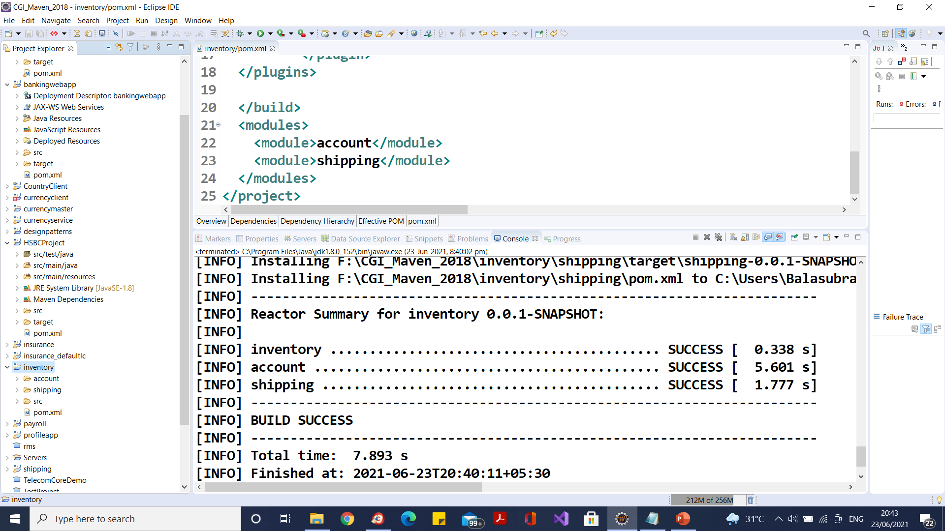
Maven Multi Module

Slide 109
Maven Multi Module
<dependency>
<groupId>junit</groupId>
<artifactId>junit</artifactId>
<version>4.12</version>
<scope>test</scope>
</dependency>
</dependencies>
</project>

Slide 110
POM
General project information
This includes a project’s name, the URL for a project, the sponsoring organization, and a list of developers and contributors along with the license for a project.
Build settings
In this section, we customize the behaviour of the default Maven build.
We can change the location of source and tests, we can add new plugins, we can attach plugin goals to the lifecycle, and we can customize the site generation parameters.

Slide 111
POM
Build environment
The build environment consists of profiles that can be activated for use in different environments.
For example, during development you may want to deploy to a development server, whereas in production you want to deploy to a production server.
The build environment customizes the build settings for specific environments and is often supplemented by a custom settings.xml in ~/.m2.
POM relationships
A project rarely stands alone; it depends on other projects, inherits POM settings from parent projects, defines its own coordinates, and may include submodules.

Slide 112
The Super POM
The Super POM is Maven's default POM.
All POMs inherit from a parent or default (despite explicitly defined or not).
This base POM is known as the Super POM, and contains values inherited by default.
Ultimately, all the application POM files get extended from the super POM.
The super POM file is at the top of the POM hierarchy and is bundled inside MAVEN_HOME/lib/maven-model-builder-3.3.3.jar - org/apache/maven/model/pom-4.0.0.xml.

Slide 113
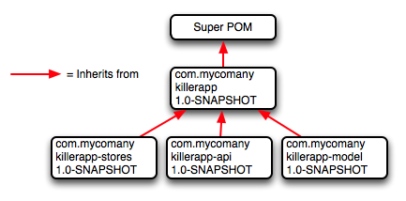
The Super POM
All the default configurations are defined in the super POM file.
Even the simplest form of a POM file will inherit all the configurations defined in the super POM file.
Whatever configuration you need to override, you can do it by redefining the same section in your application POM file.

Slide 114
The Super POM
All Maven project
POMs extend the Super POM, which defines a set of defaults shared by all projects.
This Super POM is a part of the Maven installation.
Depending on the Maven version it can be found in the maven-x.y.z-uber.jar or maven-model-builder-xy.z.jar file in ${M2_HOME}/lib.

Slide 115
Minimum POM
The minimum requirement for a POM are the following:
project root
modelVersion - should be set to 4.0.0
groupId - the id of the project's group.
artifactId - the id of the artifact (project)
version - the version of the artifact under the specified group
The Simplest POM.
<project> <modelVersion>4.0.0</modelVersion> <groupId>org.sonatype.mavenbook.ch08</groupId> <artifactId>simplest-project</artifactId> <version>1</version> </project>

Slide 116
Effective POM
The merge between the Super POM and the POM from The Simplest POM.
mvn help:effective-pom
Executing the effective-pom goal should print out an XML document capturing the merge between the Super POM and the POM from The Simplest POM.

Slide 117
What is Maven's order of inheritance?
1. parent pom 2. project pom 3. settings 4. CLI parameters

Slide 118
What is Build Profile?
A Build profile is a set of configuration values, which can be used to set or override default values of Maven build.
Using a build profile, you can customize build for different environments such as Production v/s Development environments.

Slide 119
Types of Build Profile
Type | Where it is defined
Per Project | Defined in the project POM file, pom.xml
Per User | Defined in Maven settings xml file (%USER_HOME%/.m2/settings.xml)
Global | Defined in Maven global settings xml file (%M2_HOME%/conf/settings.xml)

Slide 120
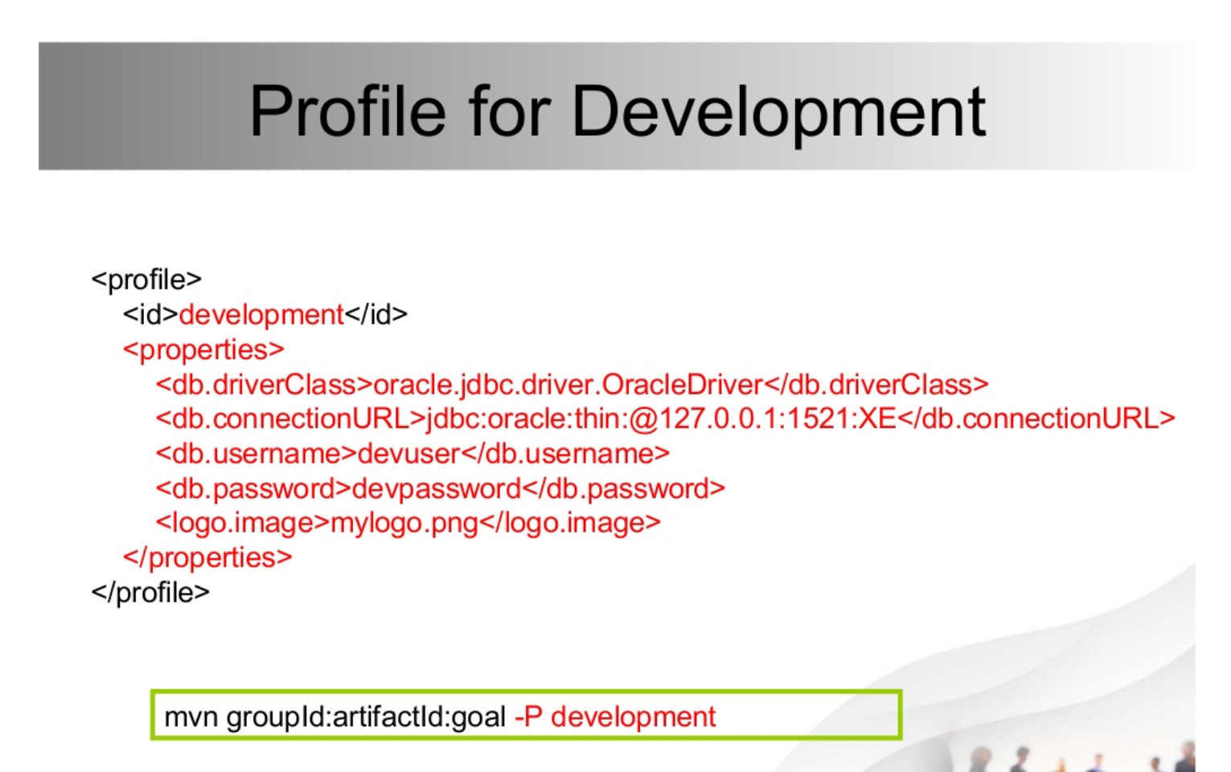
Types of Build Profile

Slide 121
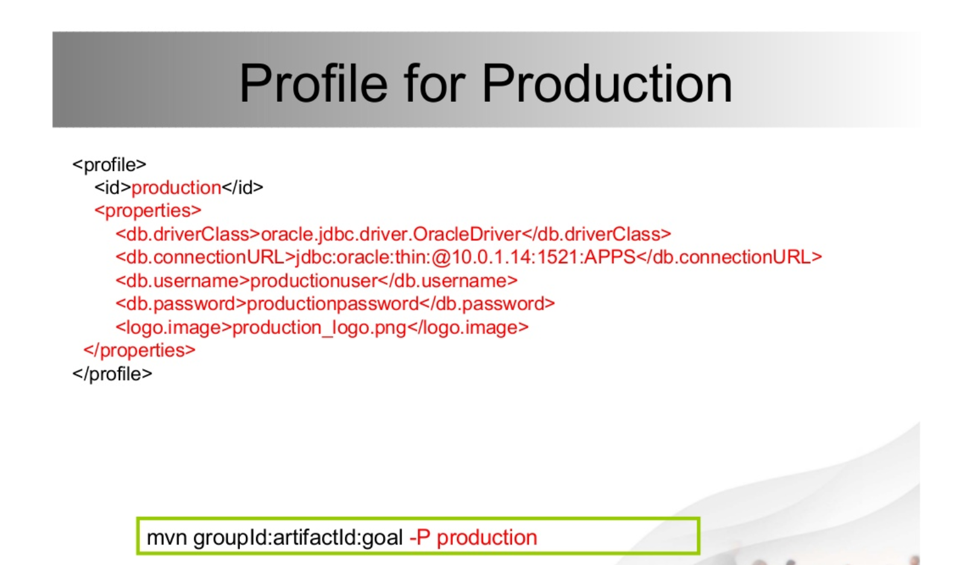

Slide 122
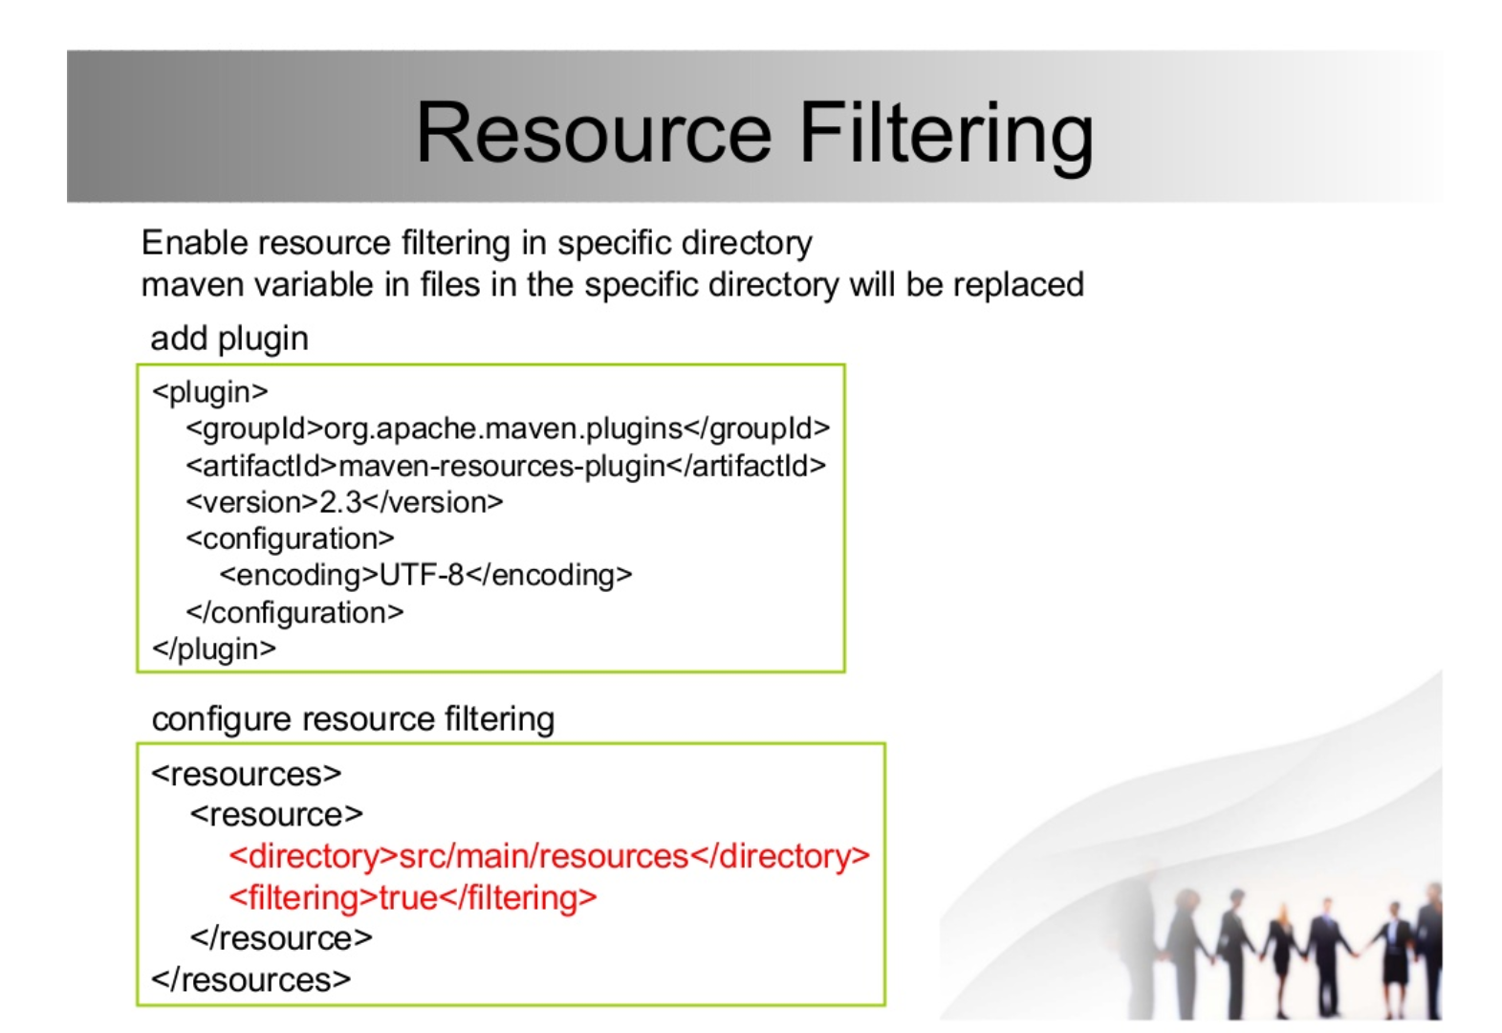

Slide 123
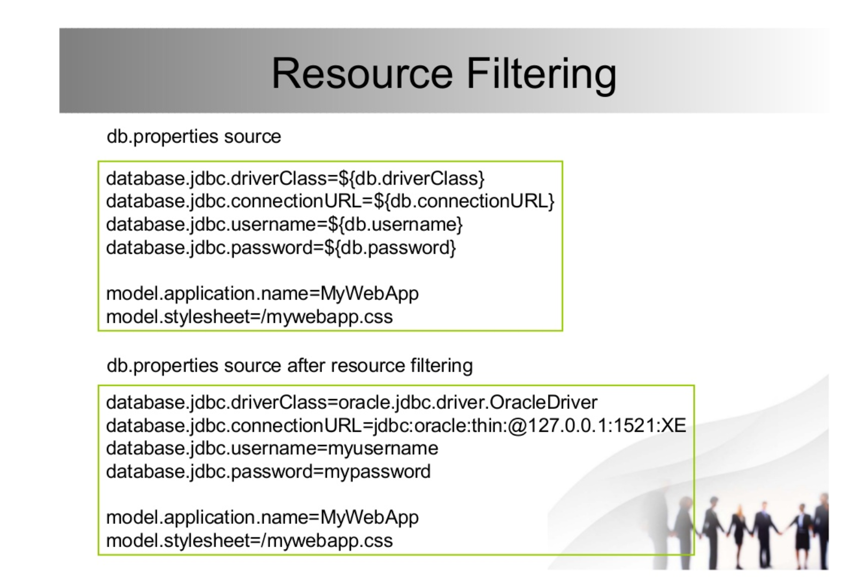

Slide 124
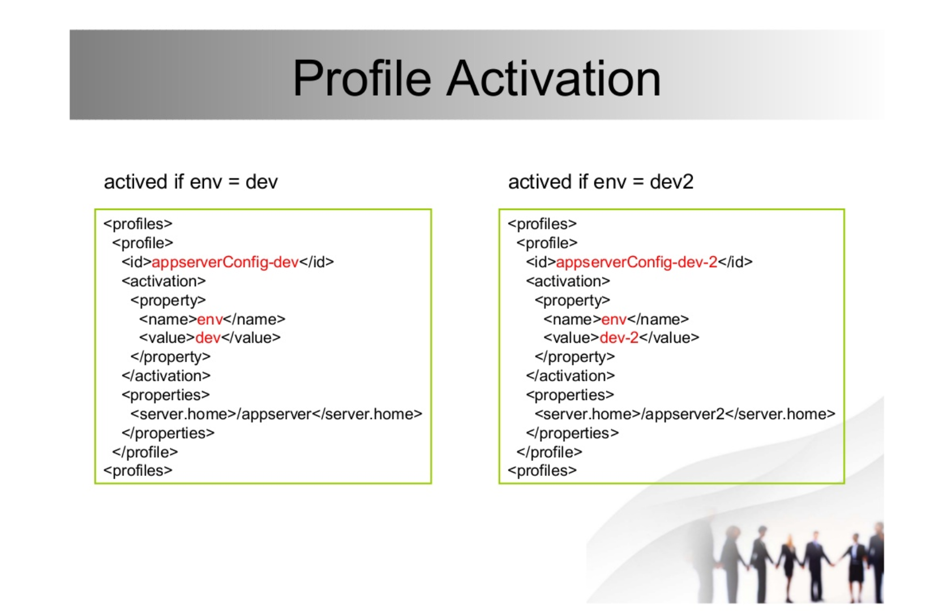

Slide 125
Maven Sonar
1. mvn clean //to clean the existing resources
2. mvn install
3. mvn sonar:sonar //to generate the reports, this command generates the report and move the reports to SonarQube dashboard. You can view your reports under project section of the Dashboard

Slide 126
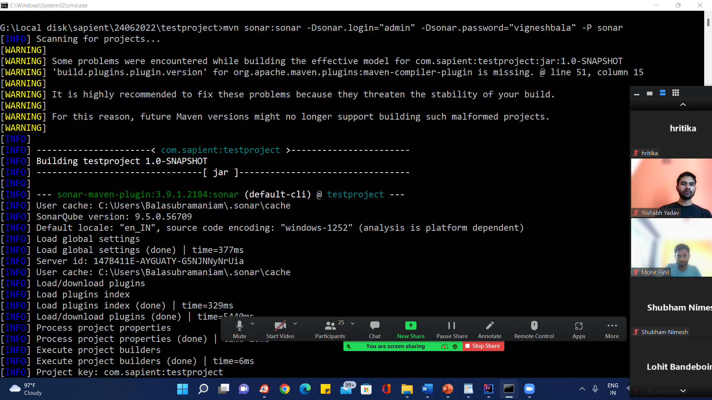
Maven Sonar

Slide 127
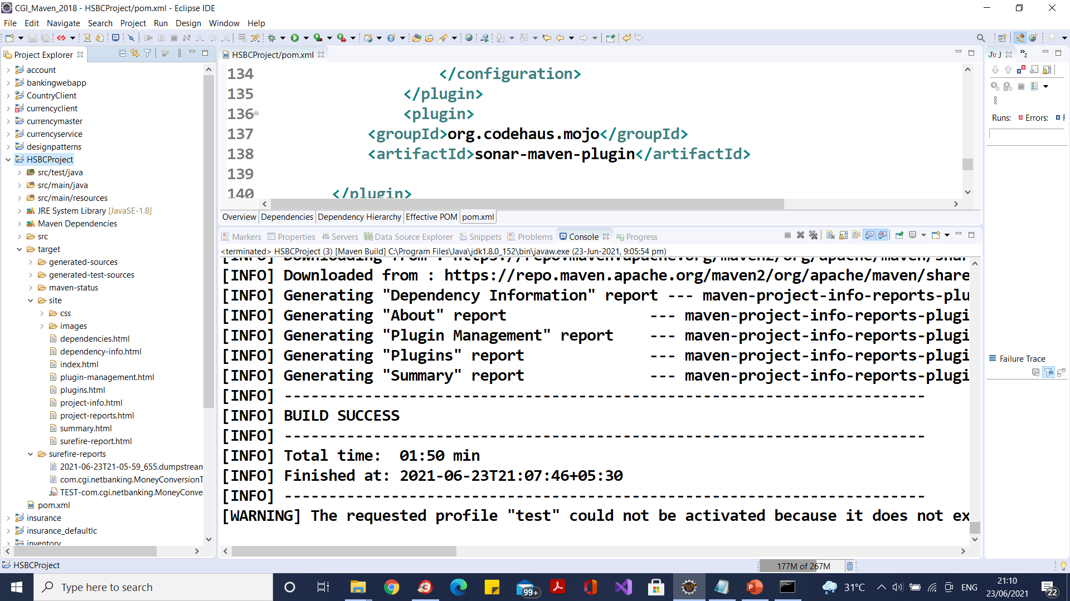
Maven Sure Fire Test Report – clean test site

Slide 128
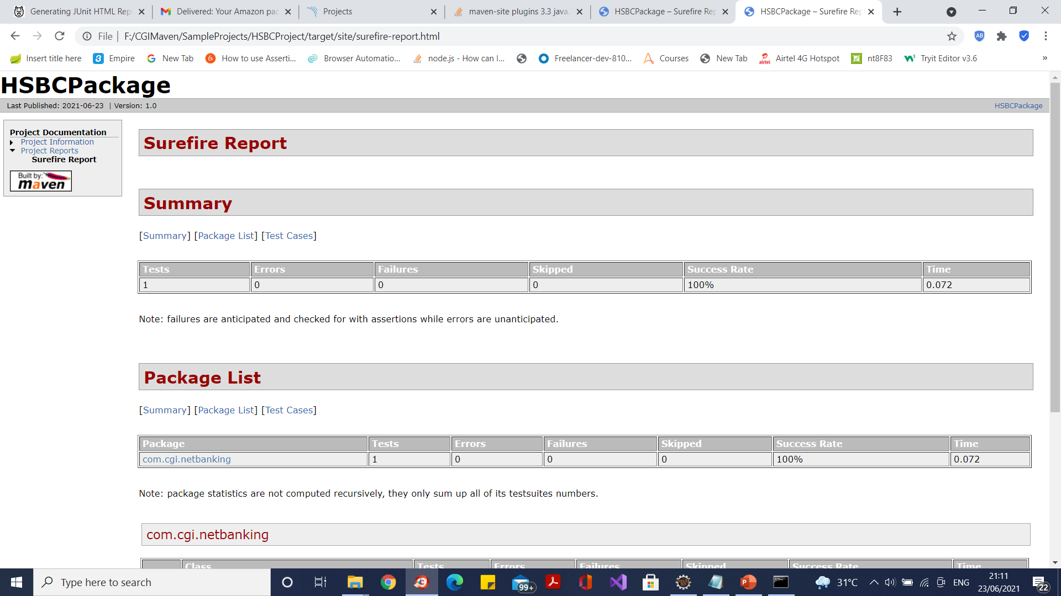
Maven Sure Fire Test Report – clean test site

Slide 129
Profile Activation
Explicitly using command console input.
Through maven settings.
Based on environment variables (User/System variables).
OS Settings (for example, Windows family).

Slide 130
Maven cheat sheet
Maven Switches

Slide 131
Maven Plugins
The maven plugins are central part of maven framework, it is used to perform specific goal.
According to Apache Maven, there are 2 types of maven plugins.
Build Plugins
Reporting Plugins

Slide 132
Maven Plugins
Build Plugins
These plugins are executed at the time of build. These plugins should be declared inside the <build> element.
Reporting Plugins
These plugins are executed at the time of site generation. These plugins should be declared inside the <reporting> element.

Slide 133
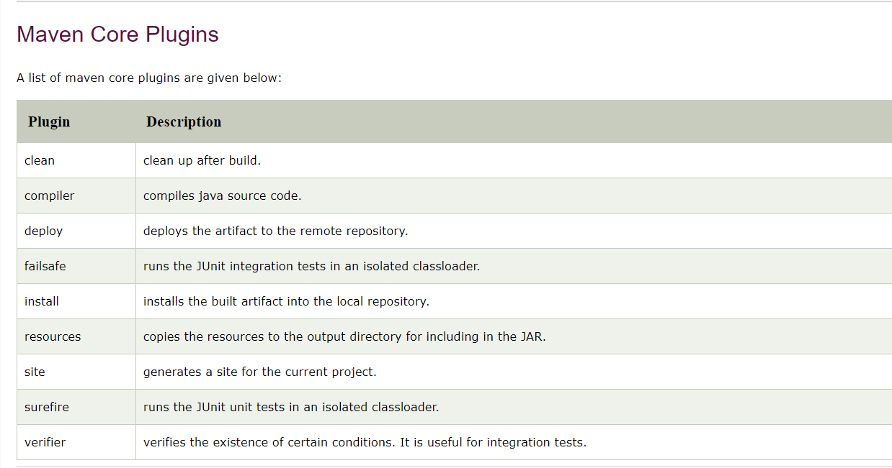
Maven Plugins

Slide 134
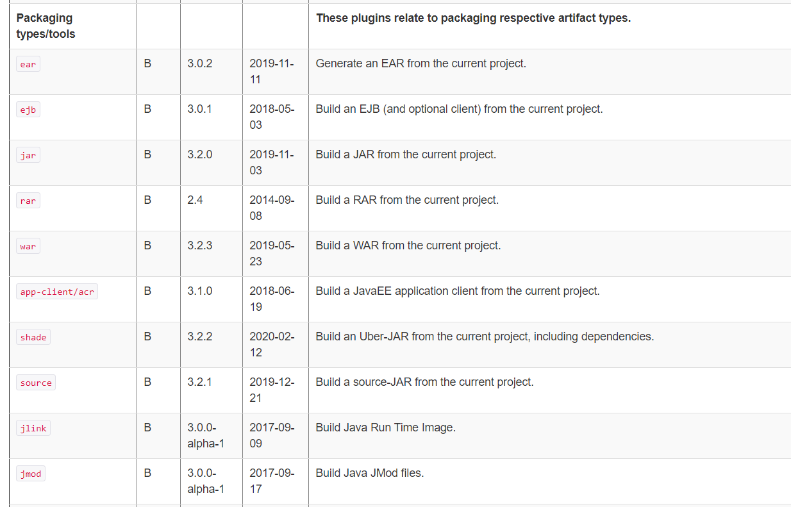
Maven Plugins

Slide 135
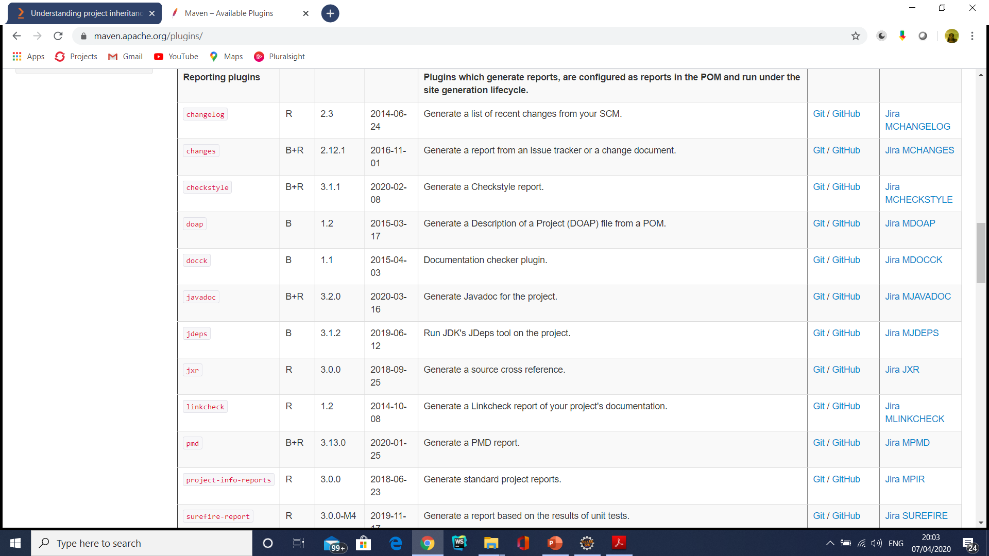
Maven Plugins

Slide 136
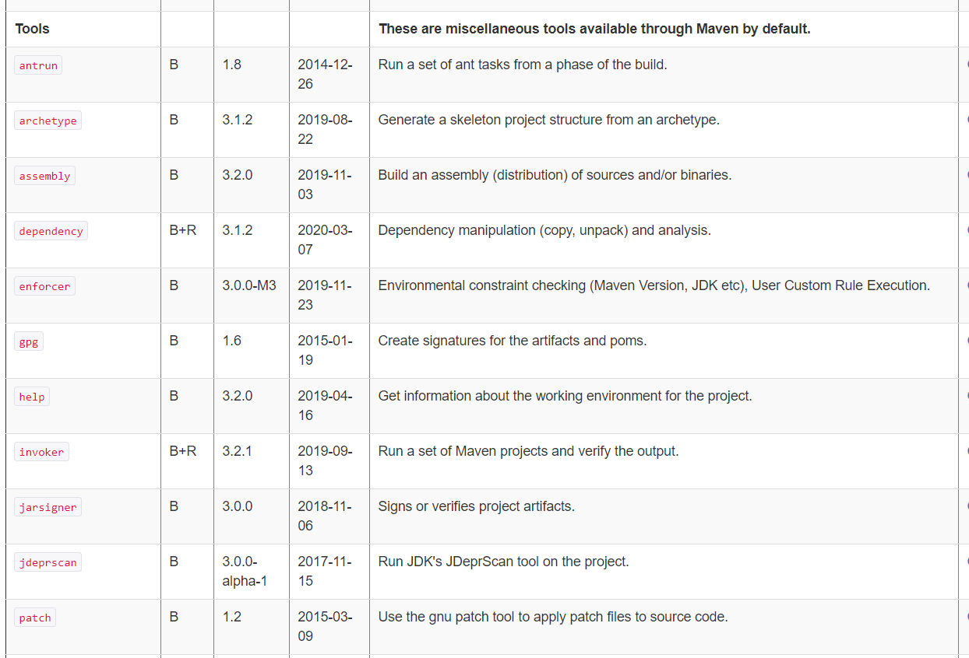
Maven Plugins

Slide 137
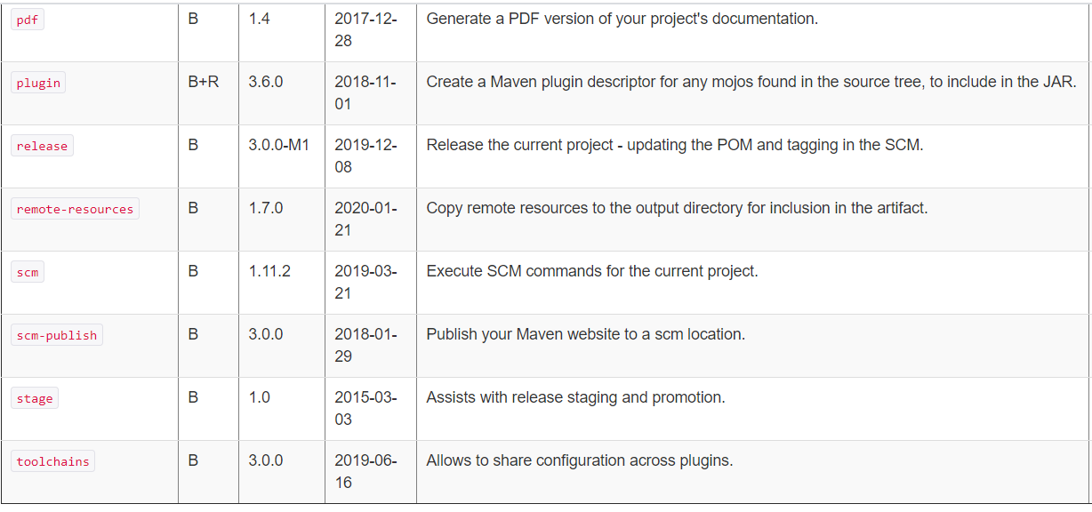
Maven Plugins

Slide 138
Maven Plugins (Hands on)
<reporting>
<plugins>
<plugin>
<groupId>org.apache.maven.plugins</groupId>
<!-- Programming Mistake Detector -->
<artifactId>maven-pmd-plugin</artifactId>
<version>3.11.0</version>
</plugin>
</plugins>
</reporting>
Mvn site

Slide 139
Maven Plugins and Goals
To execute a single Maven plugin goal, we used the syntax mvn archetype:generate, where archetype is the identifier of a plugin and generate is the identifier of a goal.
$ mvn archetype:generate -DgroupId=org.sonatype.mavenbook.simple
A Maven Plugin is a collection of one or more goals.
Examples of Maven plugins can be simple core plugins like the Jar plugin, which contains goals for creating JAR files, Compiler plugin, which contains goals for compiling source code and unit tests, or the Surefire plugin, which contains goals for executing unit tests and generating reports.

Slide 140
Maven Plugins and Goals
A goal is a specific task that may be executed as a standalone goal or along with other goals as part of a larger build.
A goal is a “unit of work” in Maven.

Slide 141
Maven Repositories
Maven repositories store a set of artifacts which are used by Maven during dependency resolution for a project.
Local repositories can be accessed on the local hard disk.
Remote repositories can be accessed through the network.
An artifact is bundled as a JAR file which contains the binary library or executable.
An artifact can also be a war or an ear.
Notes:
Faculty Notes:
Resolving Project Dependencies
During the build process, the project dependencies are resolved with the help of Maven 2 dependency management engine. Dependencies are specified in <dependencies> elements within a pom.xml file. Project dependencies are stored on repository servers. The dependencies resolver attempts to resolve the dependencies in the following order:
Your local repository is checked for the dependency.
A list of remote repositories is checked for the dependency.
In case, 1 and 2 fail, an error is reported.
By default, the first remote repository contacted in step 2 is a worldwide-accessible centralized Maven 2 repository containing artifacts for most popular open source projects.
Local Repository
Your Maven 2 local repository is a directory on your disk, located at HomeDirectory/.m2/repository. This repository acts as a high-performance local cache, storing any artifacts downloaded as a result of dependency resolution.
Remote Repository
Remote repositories are accessed over the network. You can maintain a list of remote repositories to use in your settings.xml configuration file. The settings.xml file is present in the conf folder of apache-maven-2.2.1.

Slide 142
Maven 3 Archetypes
An archetype is a complete project template
Using an archetype, a project template can be created with a simple command
Following is a list of archetypes and their purposes.
Notes:
Maven provides command line utilities using which we can create project template, similar to the project creation options in Eclipse

Slide 143
First Maven 3 project
Create the archetype
Create the source files
Create the test files
Open pom.xml and review the plugins
Execute build
Notes:
Faculty Notes:
Discuss how Maven2 works

Slide 144
First Maven 3 project
In order to create everything which is needed for a simple Java project that can be built using Maven, you can use Archetype plug-in.
Archetype is a standard plug-in which comes with Maven3.
The Archetype plug-in runs outside of a Maven project build life cycle and is used for creating Maven projects.
Notes:
Now lets see how maven works. Here are the steps
Create the archetype
Create the source files
Create the test files
Open pom.xml and review the plugins
Execute build

Slide 145
First Maven 3 project
Issue the following command from the directory that you want to contain SampleProject:
The above command provides the archetype plug-in with the coordinates of your module.
The command also creates a starter pom.xml file for the project along with the conventional Maven 3 directory structure.
mvn archetype:generate -DgroupId=com.cgi.banking -DartifactId=BankingAppln -DarchetypeArtifactId=maven-archetype-quickstart -DinteractiveMode=false

Slide 146
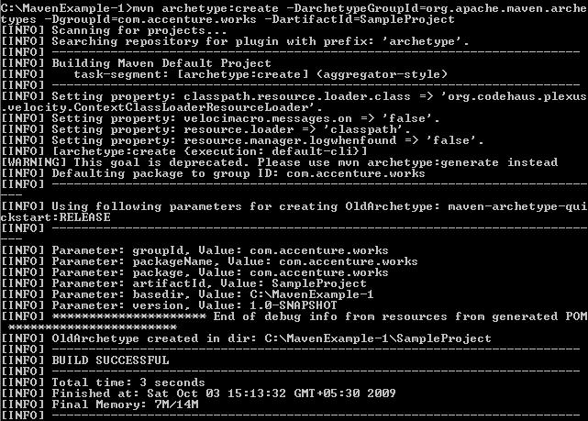
First Maven 3 project (Continued…)
The output should be similar to the following:
Notes:
Sumaiya – This is fine

Slide 147
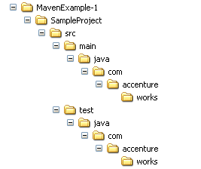
First Maven 3 project (Continued…)
The Archetype plug-in creates a directory tree, a pom.xml file and a placeholder App.java application.
It also creates a directory tree for unit test source code and a placeholder AppTest.java unit test.
The following figures shows the directory structure created:
Notes:
This is fine. Reference the steps

Slide 148
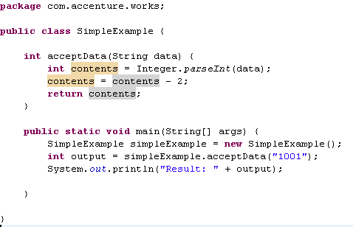
First Maven 3 project (Continued…)
Remove App.java and place the following SimpleExample.java :
Notes:
This is fine. Reference the steps

Slide 149
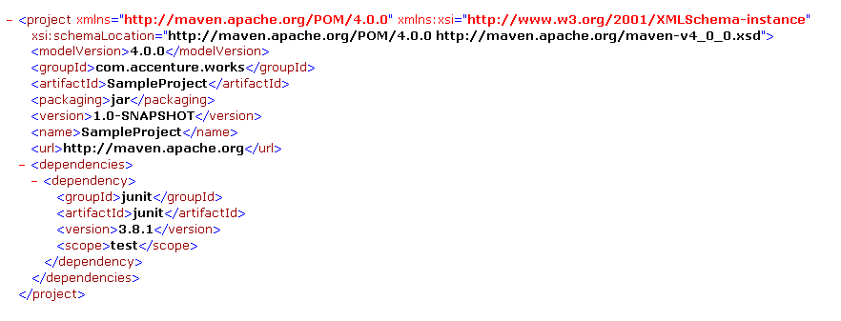
Sample pom.xml file
The file generated by the Archetype plug-in for SampleProject is shown below:
Notes:
Faculty notes:
Maven Coordinates
The group ID: The entity or organization responsible for producing the artifact. For example, com.accenture.works can be a group ID. The artifact ID: The name of the actual artifact. For example, a project with a main class. The version: A version number of the artifact.
Note how the Archetype has defined the module's coordinates, defined the type as a JAR archive, and also specified JUnit as a dependency during the test phase (via the <scope> tag).

Slide 150
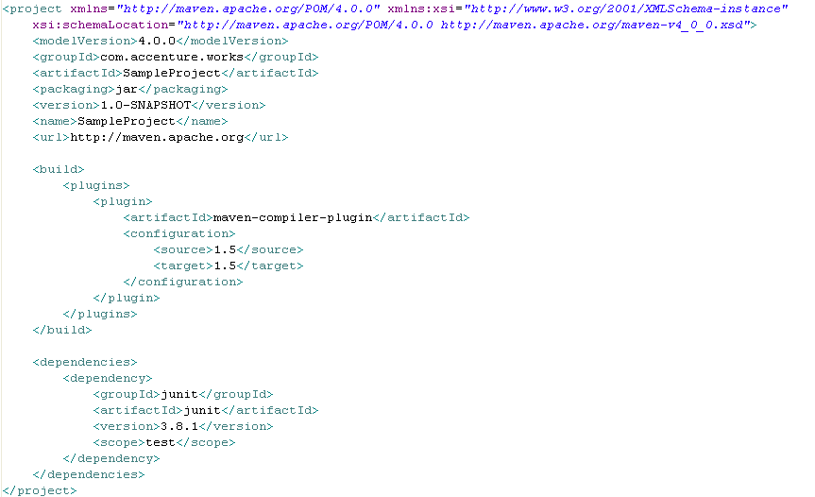

Customizing the generated pom.xml file

Slide 151
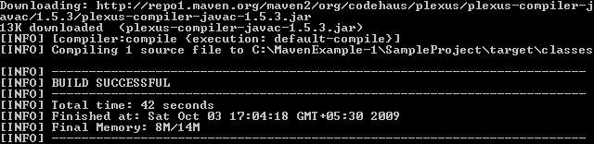
Compiling the customized Project
You can now compile the SampleProject using mvn compile command.
You should see the report of a successful build, creating one class file in the target tree.
This can take a little while if it is the first time you run it because some dependencies might need to be downloaded from the central repository over the Internet.

Slide 152
Test jar
java -cp target/my-app-1.0-SNAPSHOT.jar com.mycompany.app.App

Slide 153
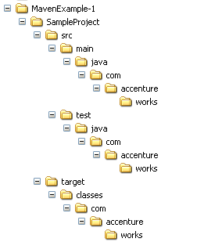
Directory structure after compilation
After compilation, the .class files (SimpleExample.class) file is created in the target folder shown below:

Slide 154
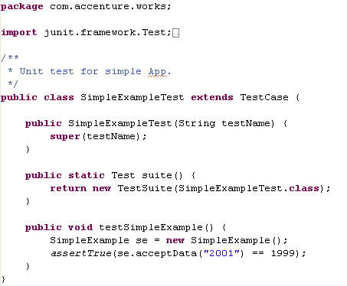
Adding a Unit test
It is a development best practice to provide unit tests for all code modules.
Maven 2 created a placeholder AppTest.java unit test for you. Remove the file and place the following SimpleExampleTest.java :

Slide 155
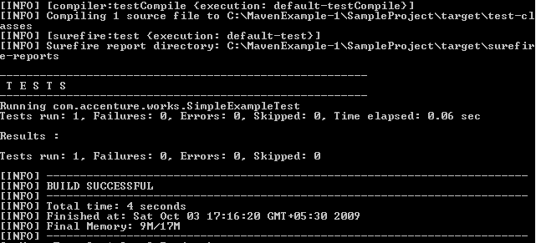
Running a unit test
You can use mvn test command.
Maven 2 compiles the source and the unit test. It then runs the tests, reporting on the number of successes, failures, and errors, as shown in the following figure:

Slide 156
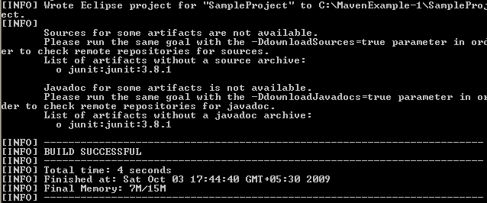
Creating eclipse specific files
It is easier for developers to work with Eclipse, hence Maven supports creation of eclipse specific files
To generate the eclipse metadata files from your pom.xml you execute the following command:
The above command generates eclipse related files like .project and .classpath .
Notes:
Participant Notes:
Eclipse IDE makes the java development easier for the developer. Thus, Maven supports creation of eclipse specific files. There is someone in the project(May be a application build engineer) who creates the Maven stuff and we developers can use it in Eclipse by importing.

Slide 157
Importing the project in Eclipse
After generating the Eclipse Classpath and Project files for your project, import the project into Eclipse with the following steps:
From the Eclipse workspace menu select File > Import
2. Expand General and select Existing Projects into Workspace
3. Mark Select root directory and hit Browse. Browse for the directory in which your POM file is in. Press OK.
4. You should now see your project checked under the Projects: box. Press Finish.
5. You should now see your project in Eclipse.

Slide 158
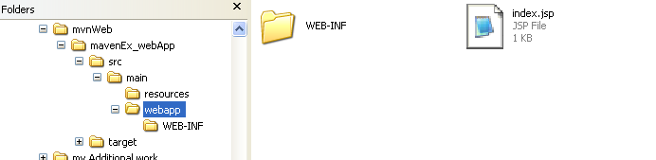
Creating a WAR file
Now let’s see how to create a simple Web application:
Execute the following command in the directory where you want the web application to be created.
The following directory structure will be created

Slide 159
Web Project Create
mvn archetype:generate -DarchetypeArtifactId=Maven-archetype-webapp -DgroupId=com.citi.fundtransfer -DartifactId=CITIMAVENFT

Slide 160

Creating a WAR file (Continued…)
The directory structure created will be as per WAR file.
Maven provides us the required directory structure and template files.
We have to create web pages and place them in the proper locations.
For our application, lets use index.jsp file which is created by default.
Add your contents to index.jsp and save it.
Give following command in the command prompt.
Notes:
Faculty notes:
-Explain to the participants that Maven just creates a web directory structure and template files like web.xml.
-We have to create the web pages and place them in the proper locations

Slide 161
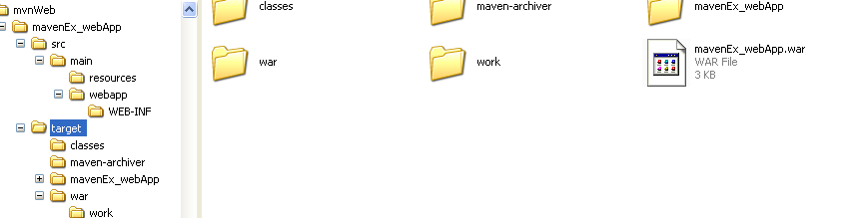
Creating a WAR file (Continued…)
Notice a war file created in the target folder
Deploy the same in a web server and request for index.jsp to see the output

Slide 162
Maven site
Mvn site

Slide 163
Custom library
mvn install:install-file -Dfile=c:\kaptcha-2.3..2.jar -DgroupId=com.google.code
-DartifactId=kaptcha -Dversion=2.3 -Dpackaging=jar
In POM.xml
<dependency>
<groupId>com.google.code</groupId>
<artifactId>kaptcha</artifactId>
<version>2.3.2</version>
</dependency>

Slide 164
Custom library
mvn install:install-file -DgroupId=com.oracle -DartifactId=ojdbc6 -Dpackaging=jar -Dversion=11.2.0.4.0 -Dfile=D:\Oracle\app\oracle\product\11.2.0\server\jdbc\lib\ojdbc6.jar -DgeneratePom=true
In POM.xml
<!-- https://mvnrepository.com/artifact/com.oracle/ojdbc6 -->
<dependency>
<groupId>com.oracle</groupId>
<artifactId>ojdbc6</artifactId>
<version>11.2.0.4.0</version>
<scope>runtime</scope>
</dependency>

Slide 165
Local Repository
{M2_HOME}\conf\setting.xml
<settings>
<!-- localRepository
| The path to the local repository maven will use to store artifacts.
|
| Default: ~/.m2/repository
<localRepository>/path/to/local/repo</localRepository>
-->
<localRepository>D:/maven_repo</localRepository>
<interactiveMode>true</interactiveMode>
<usePluginRegistry>false</usePluginRegistry>
<offline>false</offline>

Slide 166
Maven: See It
Demonstration:
Faculty will demonstrate how to create a simple Java program using Maven and the Eclipse IDE
Time Allocated: 10 minutes
Environment or File : Eclipse
Steps:
Open Eclipse
Create a new Maven project without using any archetype
Expand the source tree and target tree and provide a walk through.
Open pom.xml and provide a walkthrough
Create a new package com.accenture.adfx.module1.sample
Create a new Java file with a main method printing “Hello World” to the console
Build and Run the file using Maven
Notes:
Faculty Notes:
The objective of this demo is to show how to use Eclipse to create a simple Maven project.
Demonstrate how to create a simple Java project using Maven and Eclipse.
This demo requires Eclipse with Maven Plugin and Maven installed on the laptop.
Open Eclipse
Create a new Maven project without using any archetype.
Expand the source tree and target tree and provide a walk through.
Open pom.xml and provide a walkthrough
Create a new package com.accenture.adfx.module1.sample1
Create a new Java file with a main method printing “Hello World” to the console
Build and Run the file using Maven.
Participant Notes:
Pay attention as your faculty member creates the simple Java project using Maven. You will be asked to create one after this demonstration.

Slide 167
Maven: Try - It
Now Try It:
Create a simple Java project using Maven
Time Allocated: 15 minutes
Environment or File : Eclipse
Steps:
Open Eclipse
Create a new Maven project without using any archetype
Expand and view the source tree and target tree
Open and observe the generated pom.xml
Create a new Java file in the com.accenture.adfx.module1.sample package with a main method printing “Hello World” to the console
Build and Run the file using Maven
Notes:
Faculty Notes:
The fully annotated solution code is found in the Faculty Guide.
Present the task that participants must try themselves.
Walk around the room in case anyone needs assistance.
Participant Notes:
Create a Simple Java project
Open Eclipse
Create a new Maven project without using any archetype.
Expand and observe the source tree and target tree.
Open and observe the generated pom.xml
Create a new package com.accenture.adfx.module1.sample1
Create a new Java file with a main method printing “Hello World” to the console.
Build and Run the file using Maven.

Slide 168

Maven: Activity
Objective:
Create a Maven project using maven-archetype-webapp and learn how to build and package the web application into a war
Time Allocated: 30 min
Environment or File: Eclipse
Instructions:
Open Eclipse
Create a Maven using maven-archetype-webap archetype.
Expand and observe the source tree and target tree.
Open and observe the generated pom.xml
Open index.jsp and modify the default message.
Build the project using Maven.
Package into a war file using Maven.
Deploy and run on tomcat.

Slide 169
Questions

Slide 170
Module Summary
In this module we discussed
Overview of Maven
Maven archetypes
Maven life cycle phases
The pom.xml file
Creation of Java projects using Maven
Creation of war files

